Slide 1
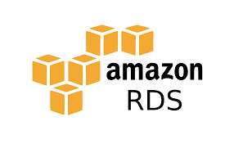
Amazon RDS Free Storage Space Alarm Setup

Slide 2
Agenda
1
2
3
4
5
Introduction
Overview
Prerequisites
Steps to Create an RDS
Testing and Validation

Slide 3
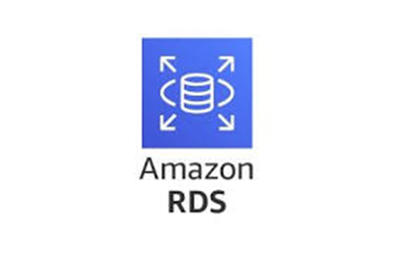
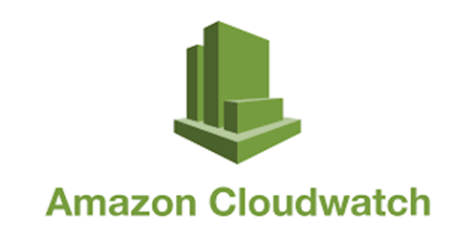
Introduction
RDS :
Amazon Relational Database Service (Amazon RDS) is an easy-to-manage relational database service optimized for total cost of ownership. It is simple to set up, operate, and scale with demand. Amazon RDS automates undifferentiated database management tasks, such as provisioning, configuring, backing up, and patching.
Amazon RDS is a relational database that is used to store, organize, and provide access to related data for data analysis, modeling, reporting, and other business use cases.
Cloudwatch :
Amazon CloudWatch is a monitoring and management service that provides data and actionable insights for AWS, on-premises, hybrid, and other cloud applications and infrastructure resources.
CloudWatch gives visibility into system-wide performance and allows users to set alarms, automatically react to changes, and gain a unified view of operational health.

Slide 4
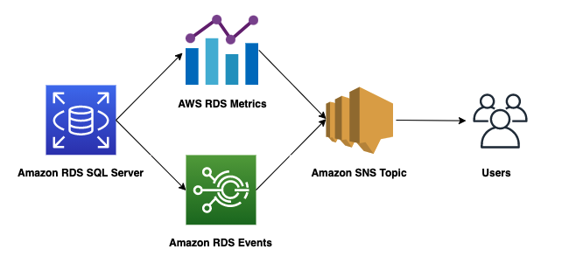
Overview of the Solution
Create an RDS database instance.
Create a CloudWatch alarm for free storage space to proactively monitor database storage.
Configure threshold conditions to trigger alerts when free storage space goes below a certain level.
Use Amazon Simple Notification Service (SNS) to send email alerts to specified recipients.
Automate notifications to ensure quick responses to potential storage issues.

Slide 5

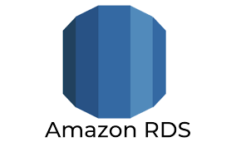
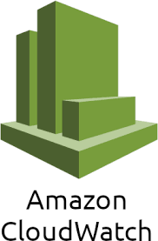

Prerequisites
AWS Account
RDS instances
CloudWatch
SNS

Slide 6
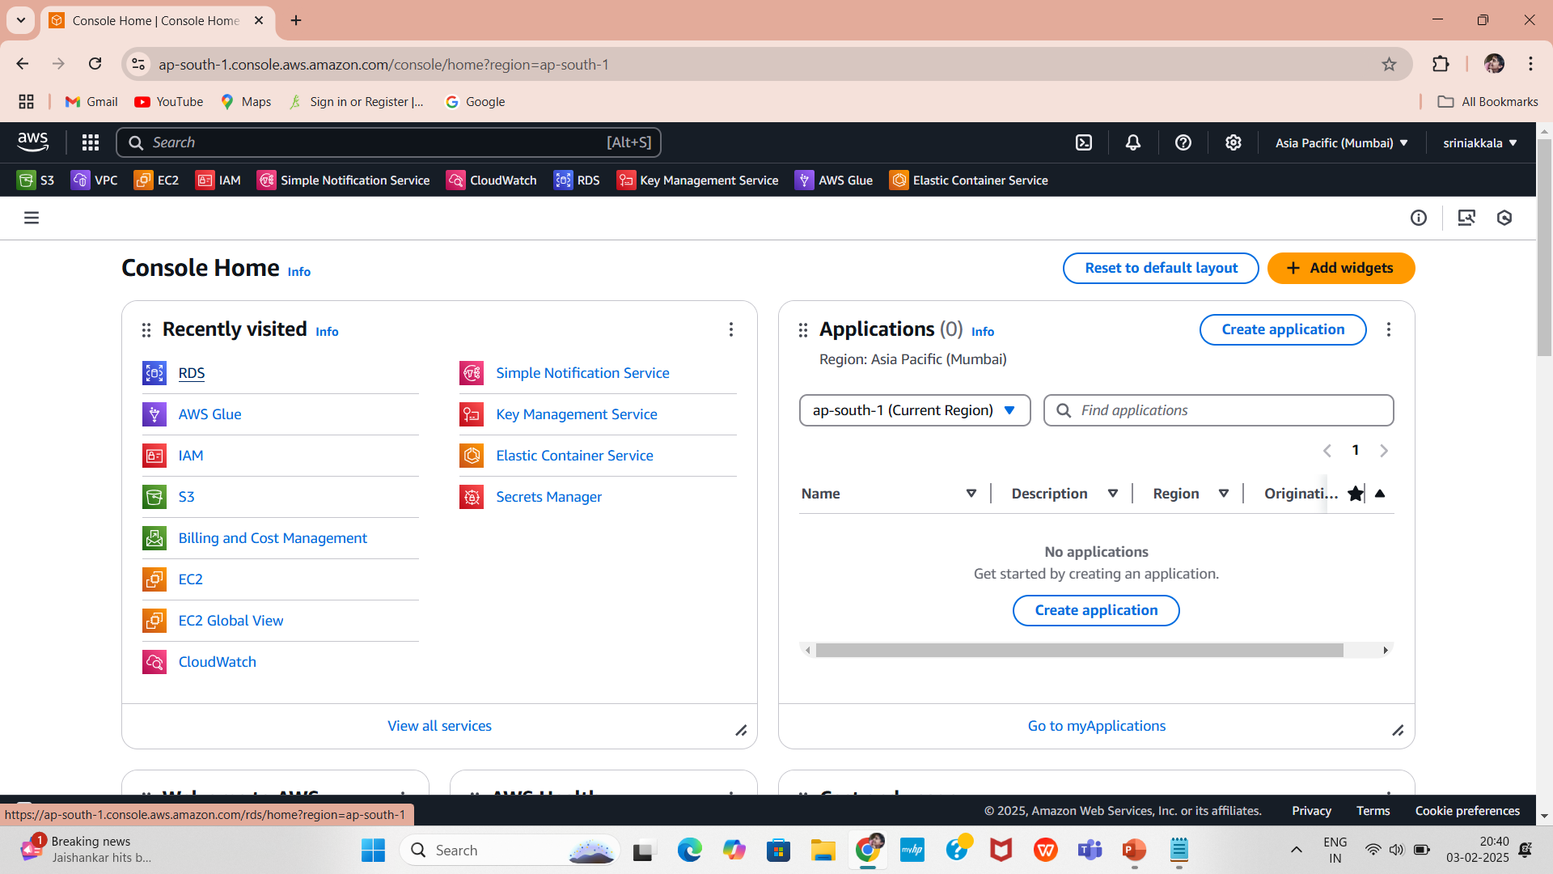
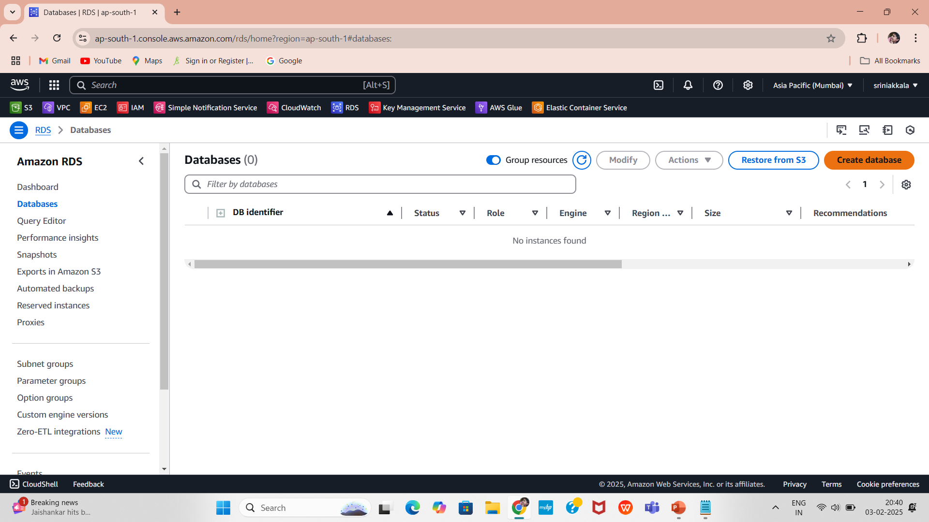
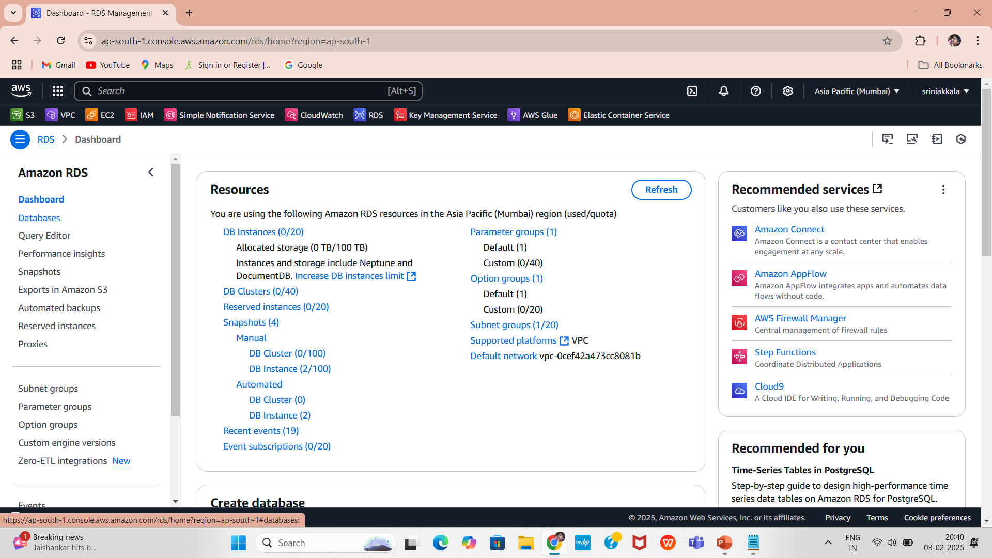
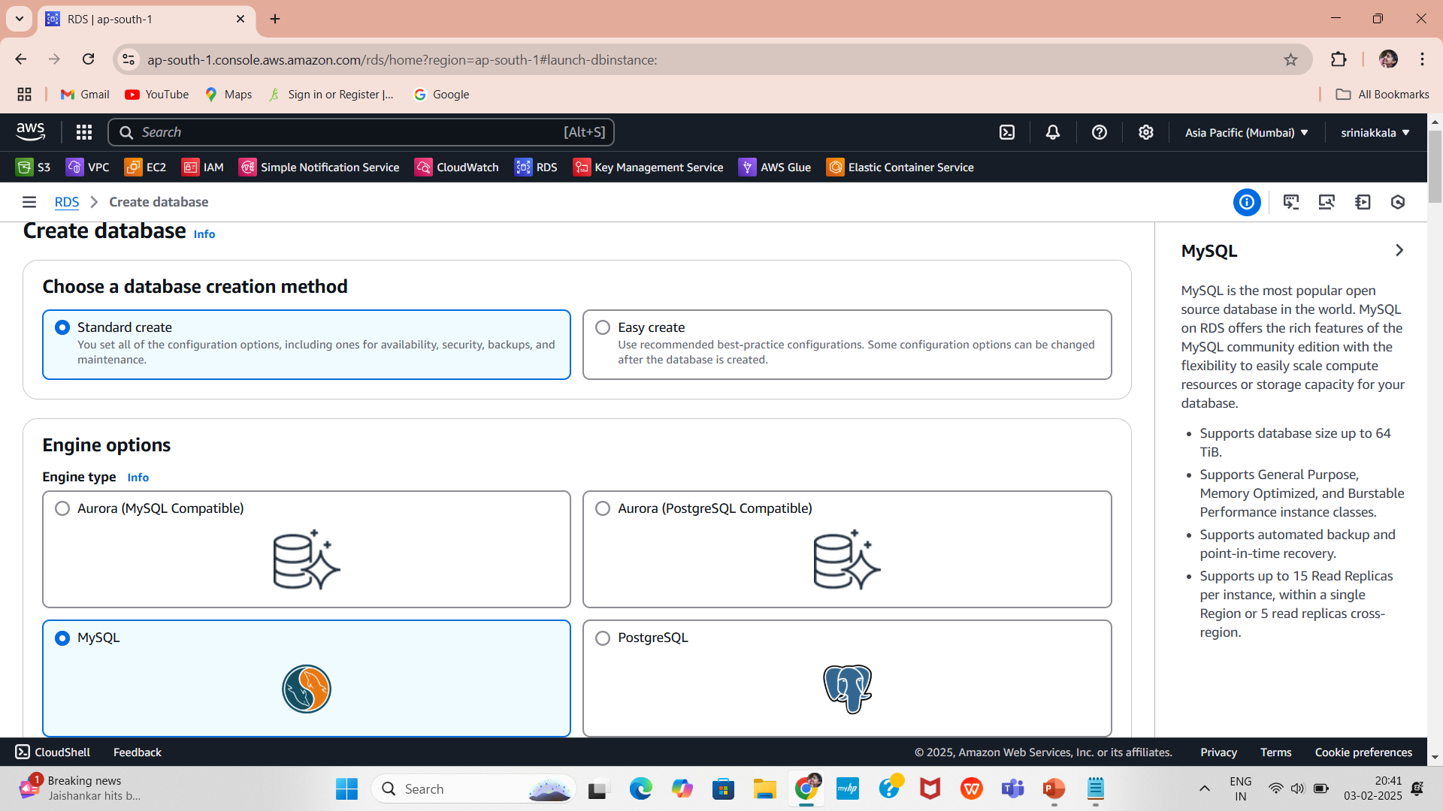
Steps to Create an RDS Instance
1.Go to the AWS Management Console
Sign in to your AWS account.
2.Navigate to the Amazon RDS service.
3.Choose "Create Database"
Click the “Create database” button.
4. Select Standard Create.
Select the Database Engine
Choose the desired database engine (e.g., MySQL).

Slide 7
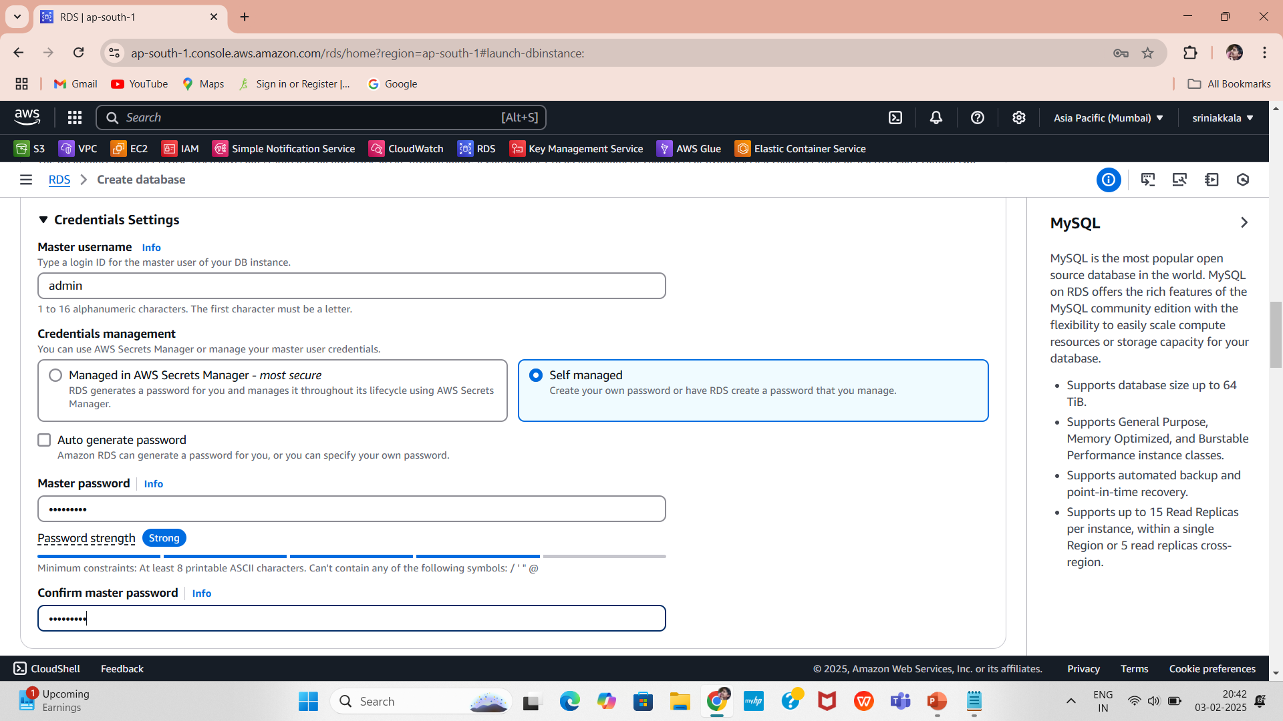
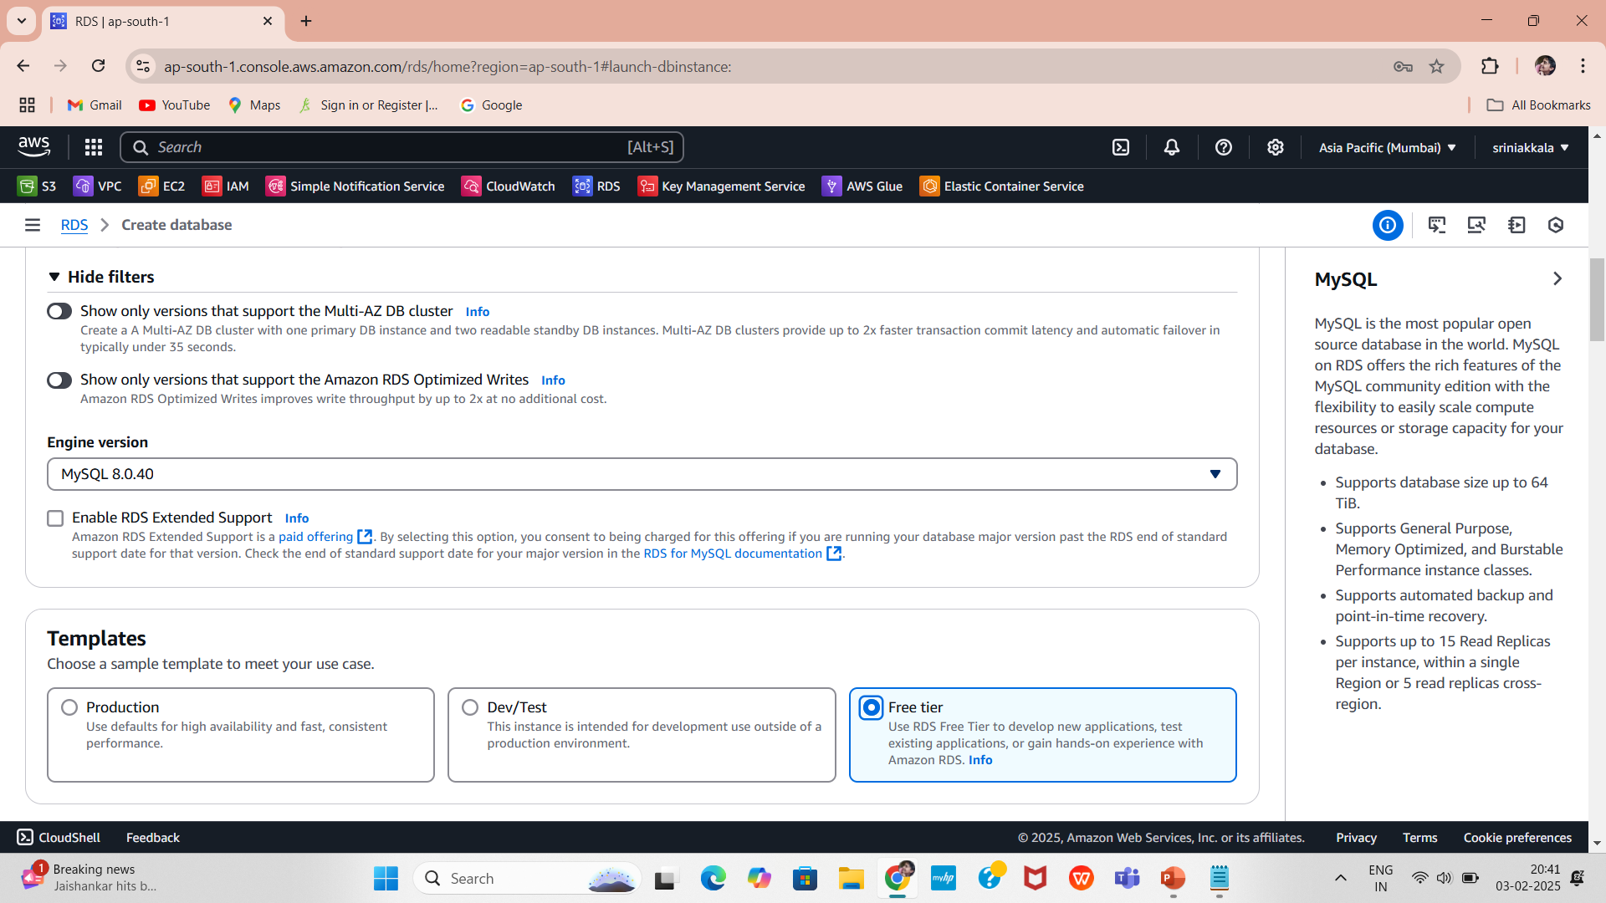
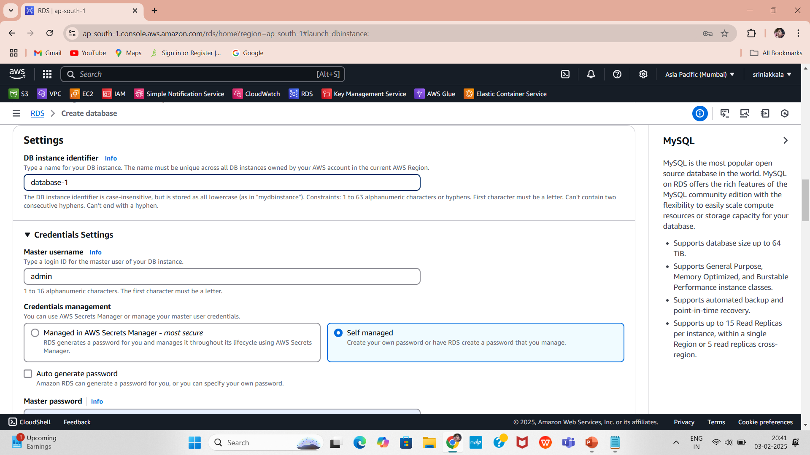
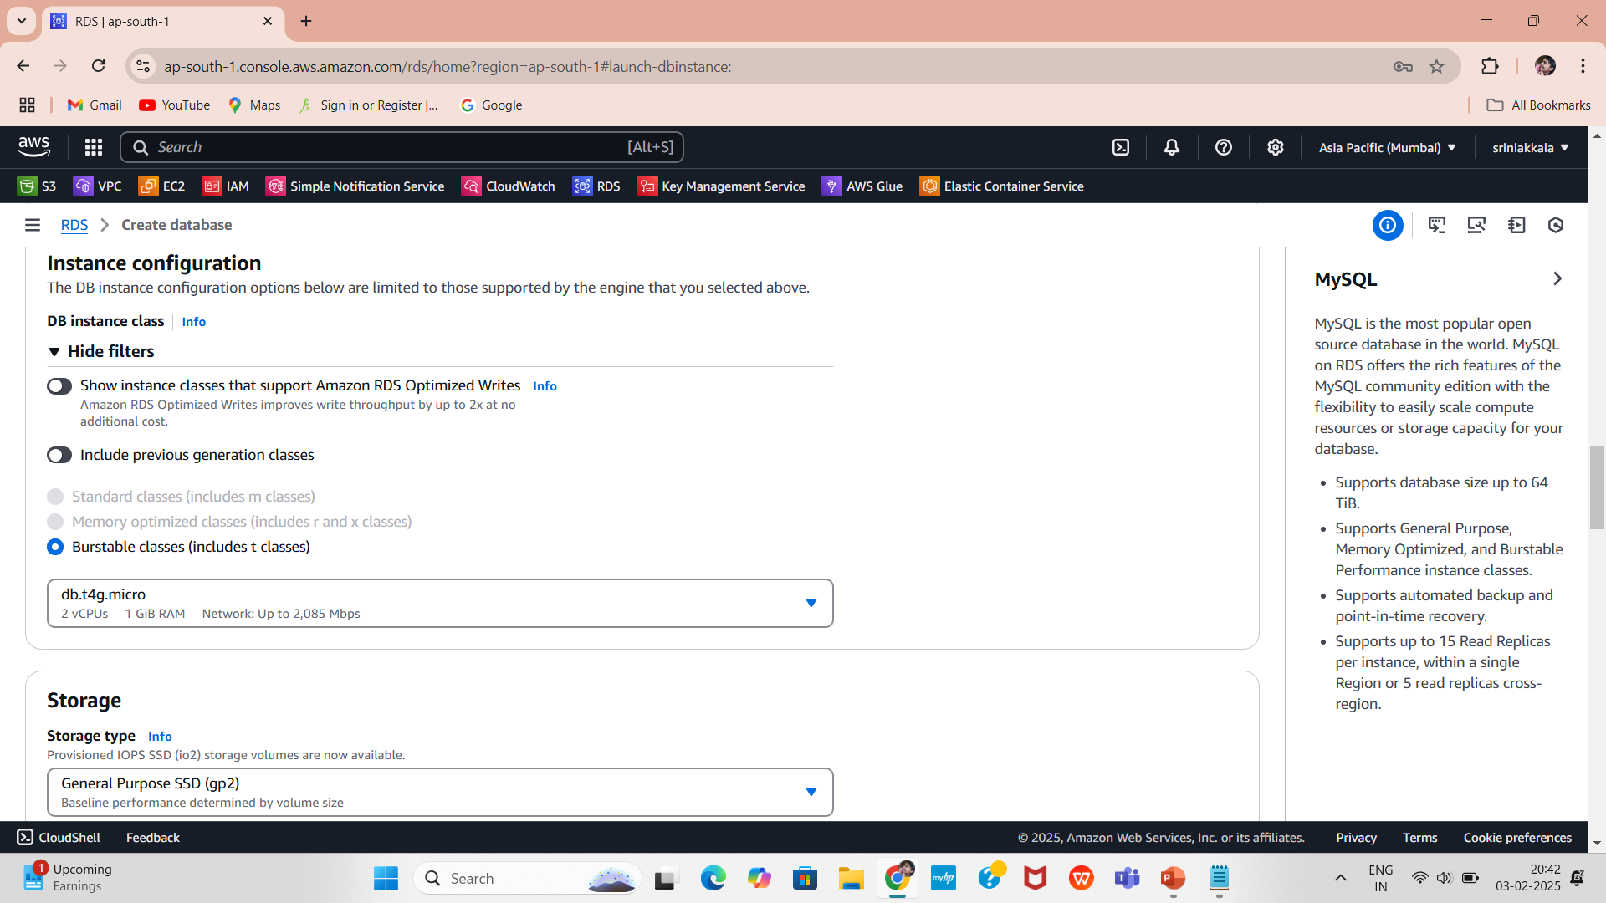
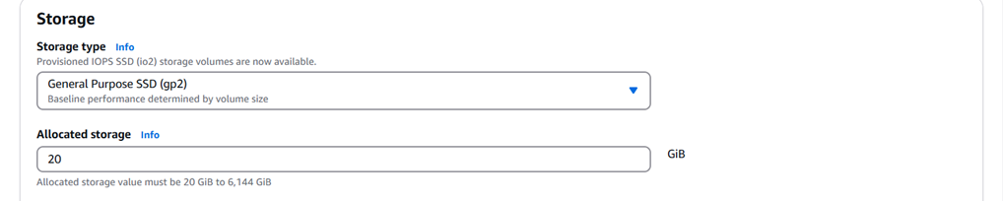
5.Select the version you want to use and choose a sample template to meet your use case Free tier.
7.Set a Master username (admin) and Master password for authentication.
6.Configure Settings
Enter a DB instance identifier (a unique name for your database (database-1)).
8.Select Instance Type and Storage
Choose an instance type based on CPU and memory requirements.
Specify storage capacity (e.g., 20GB ).

Slide 8
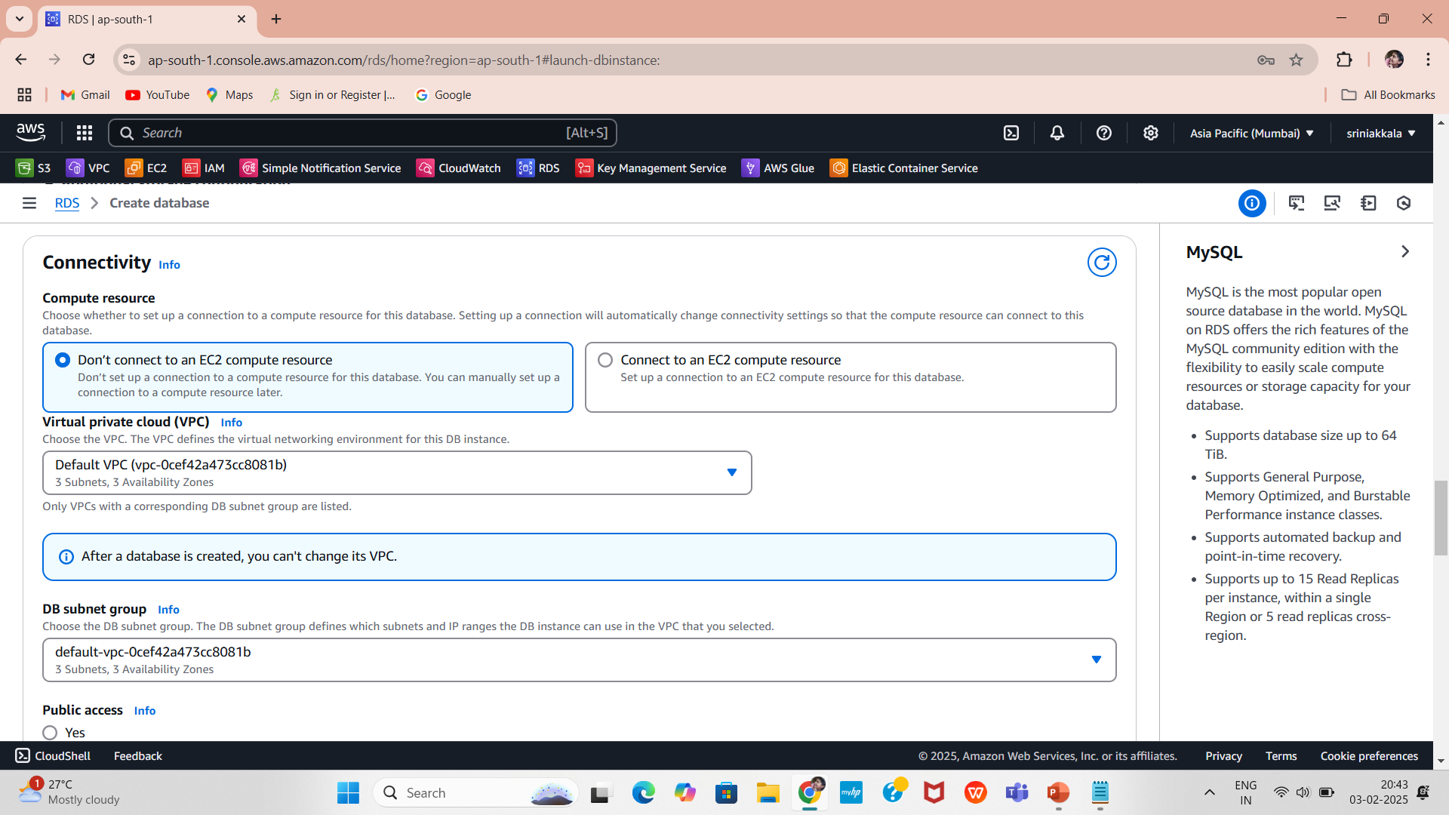
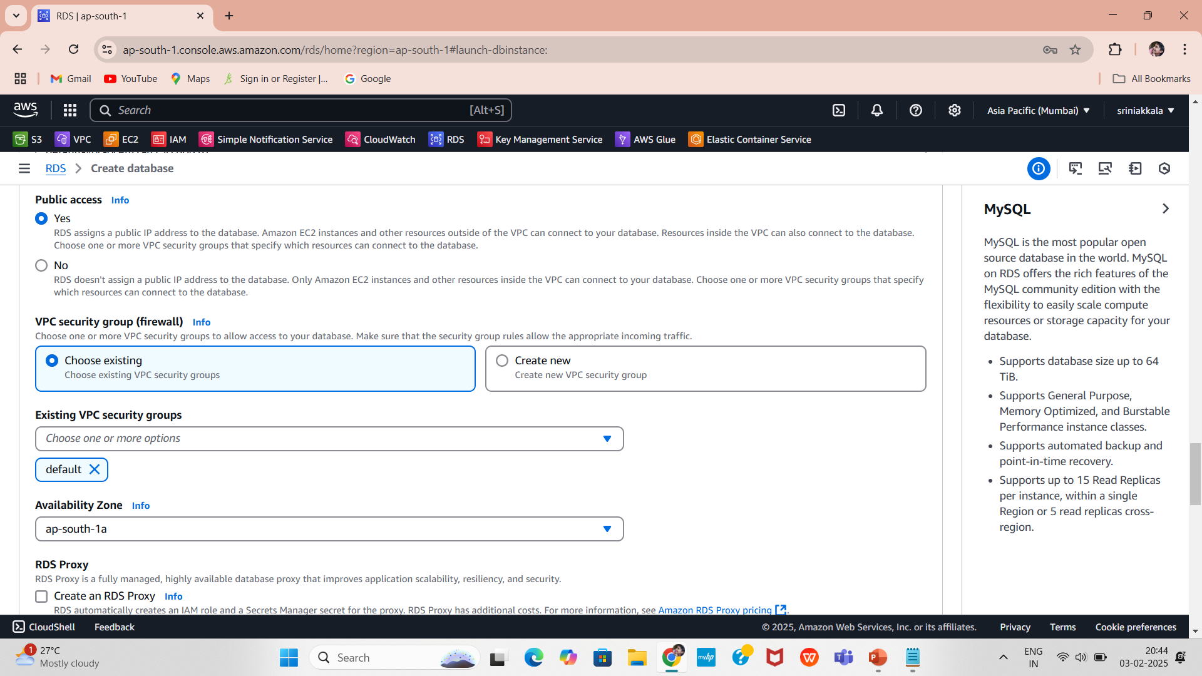
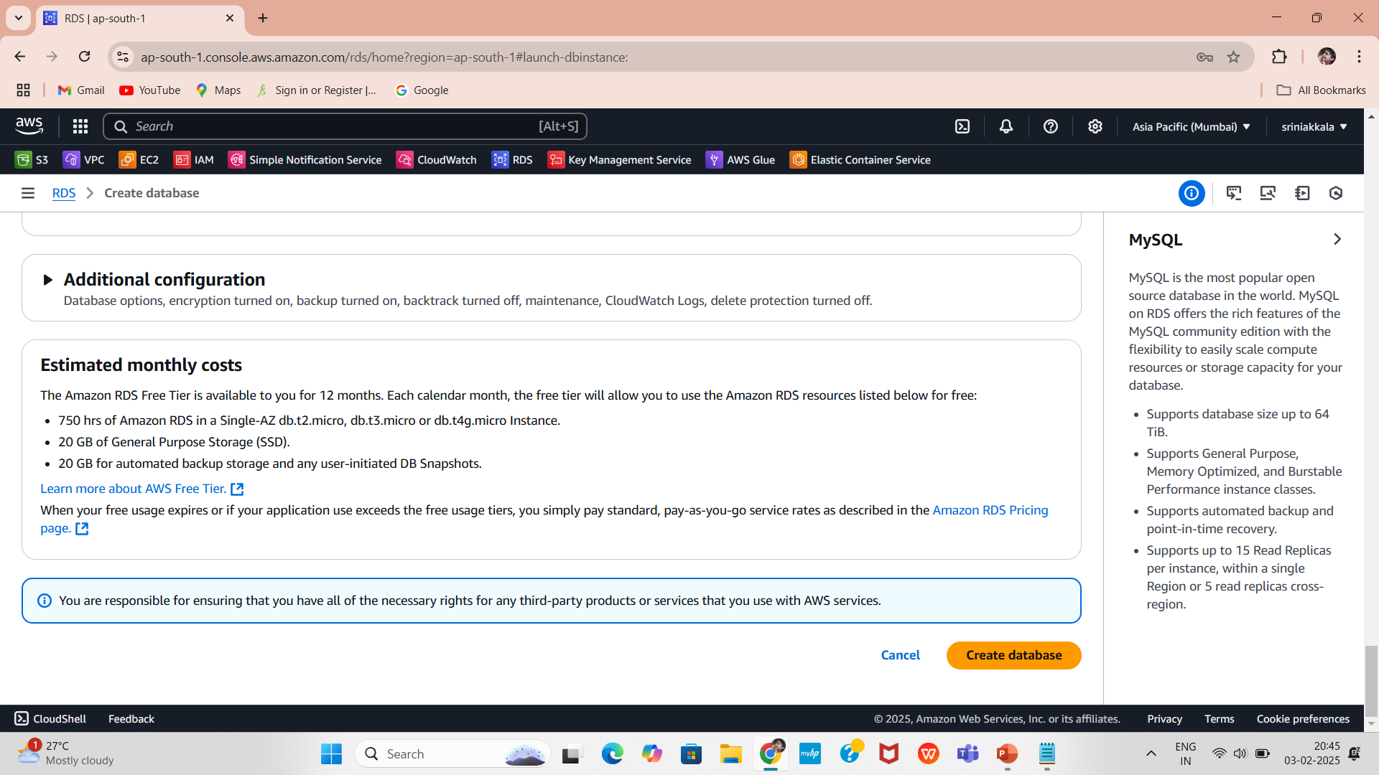
9.Configure Connectivity
Choose a Virtual Private Cloud (VPC) and subnet group.
10.Enable public access if required.
Configure security groups and authentication settings.
11. Review the configurations and click Create Database.
Wait for the database to be available.

Slide 9

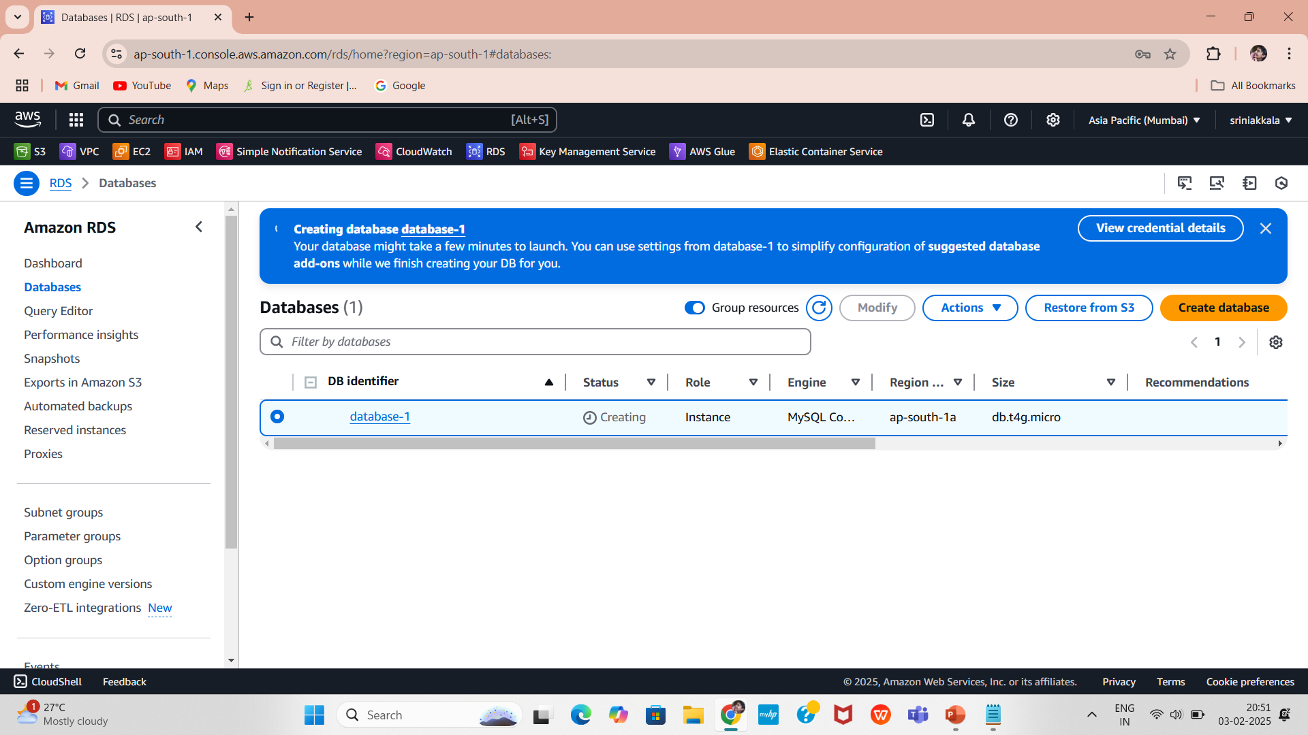
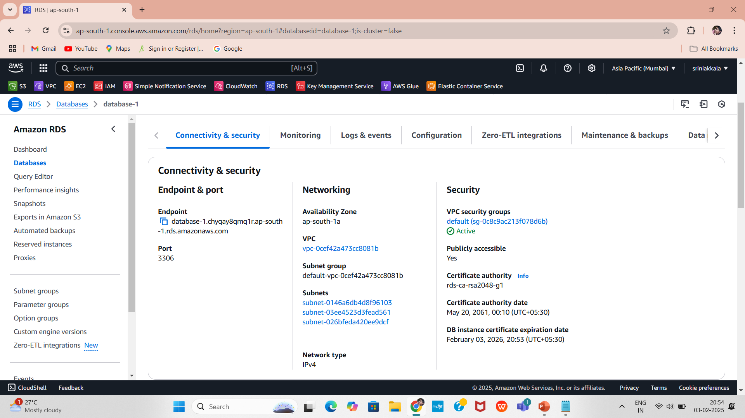
12.Get RDS Connection Details
Review the configurations that database-1 is created.
Locate the security group associated with the RDS instance:
Edit Inbound Rules
Add a rule:
Type: MySQL/Aurora
Protocol: TCP
Port: 3306
Copy the Endpoint
Note down the Port (3306), admin, and Password

Slide 10
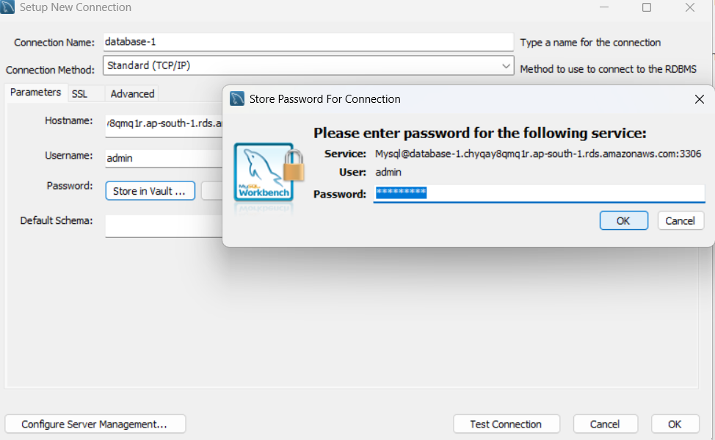
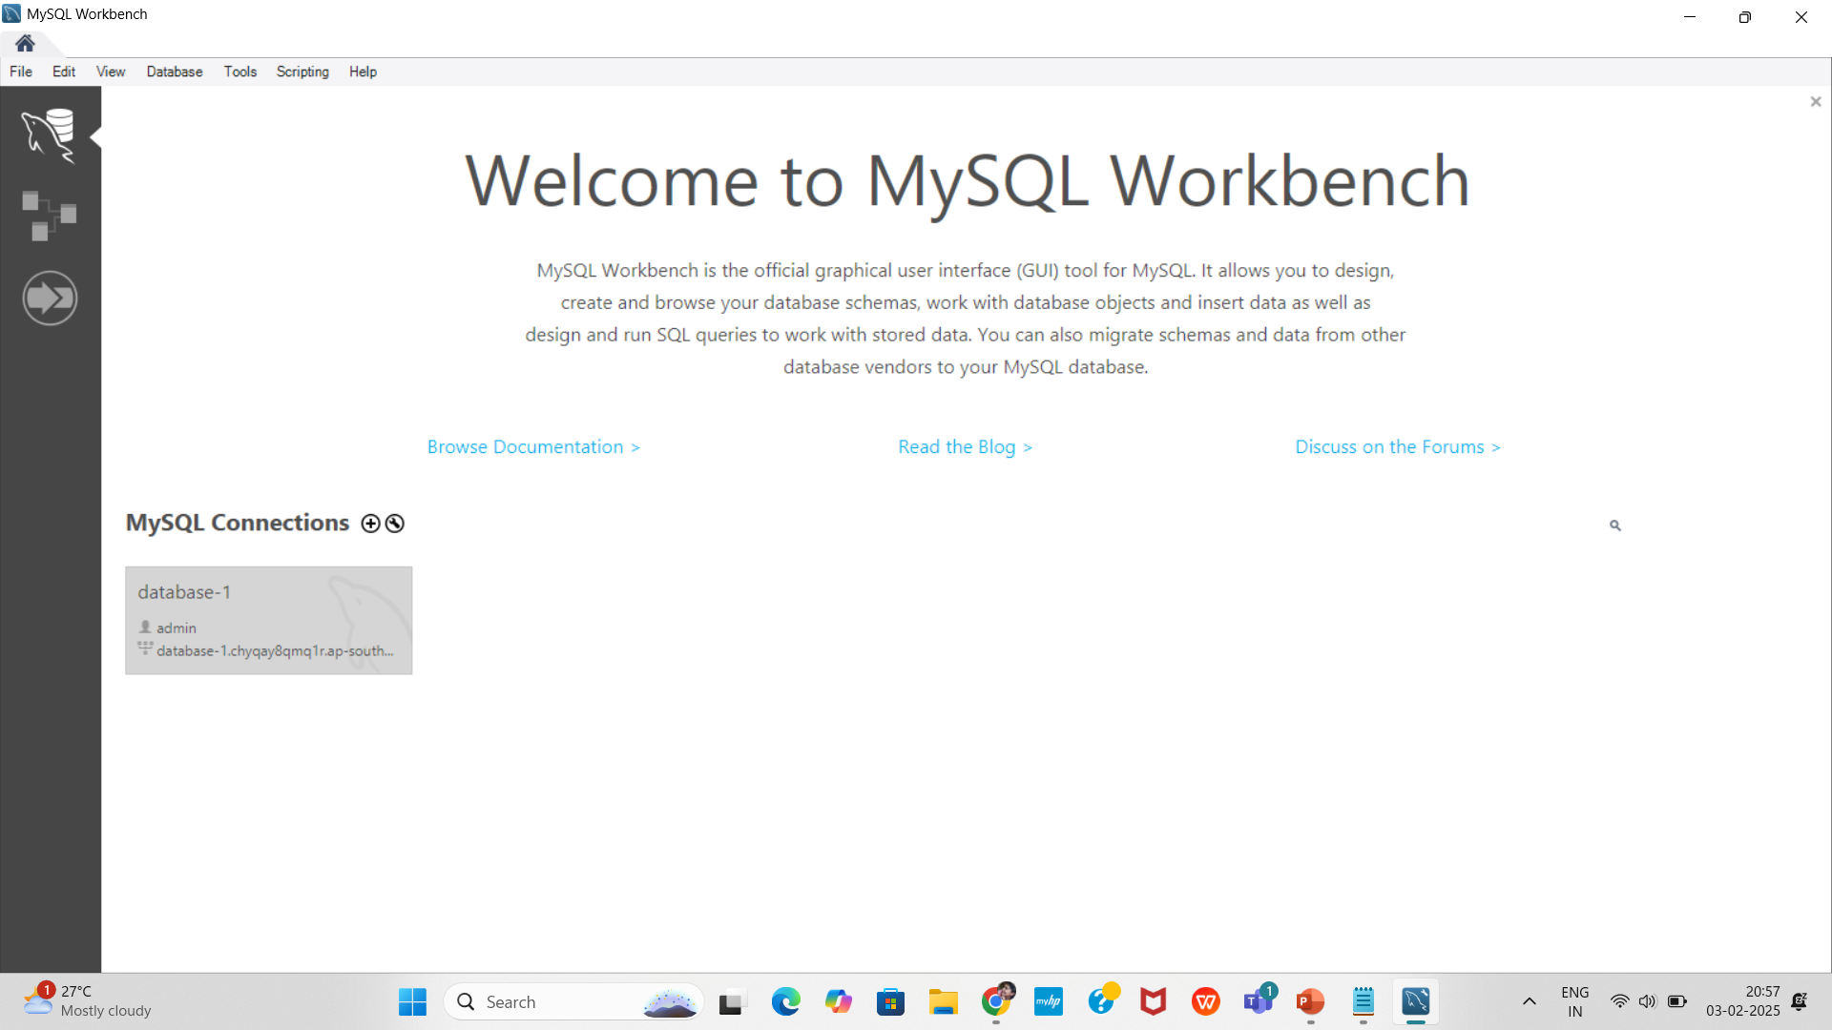
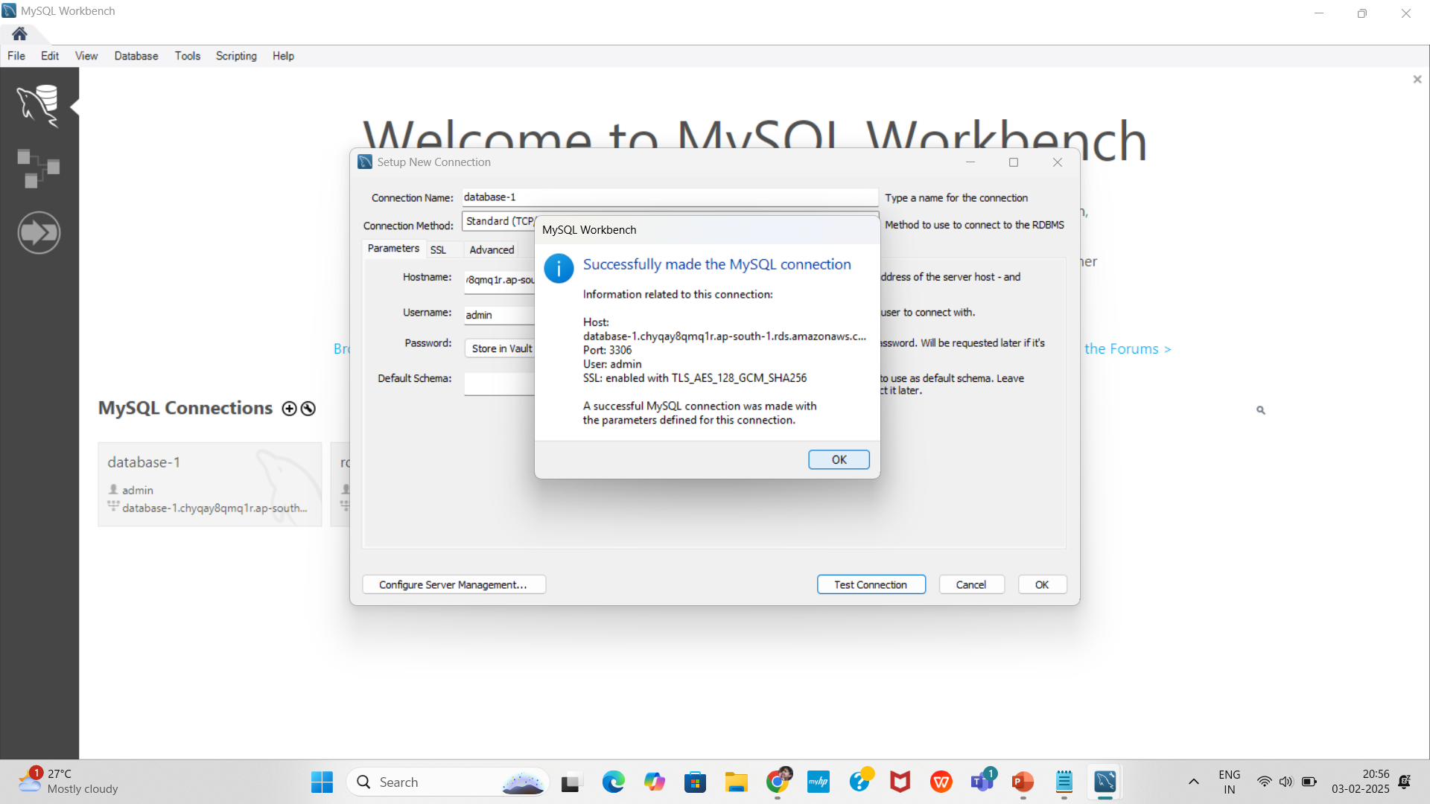
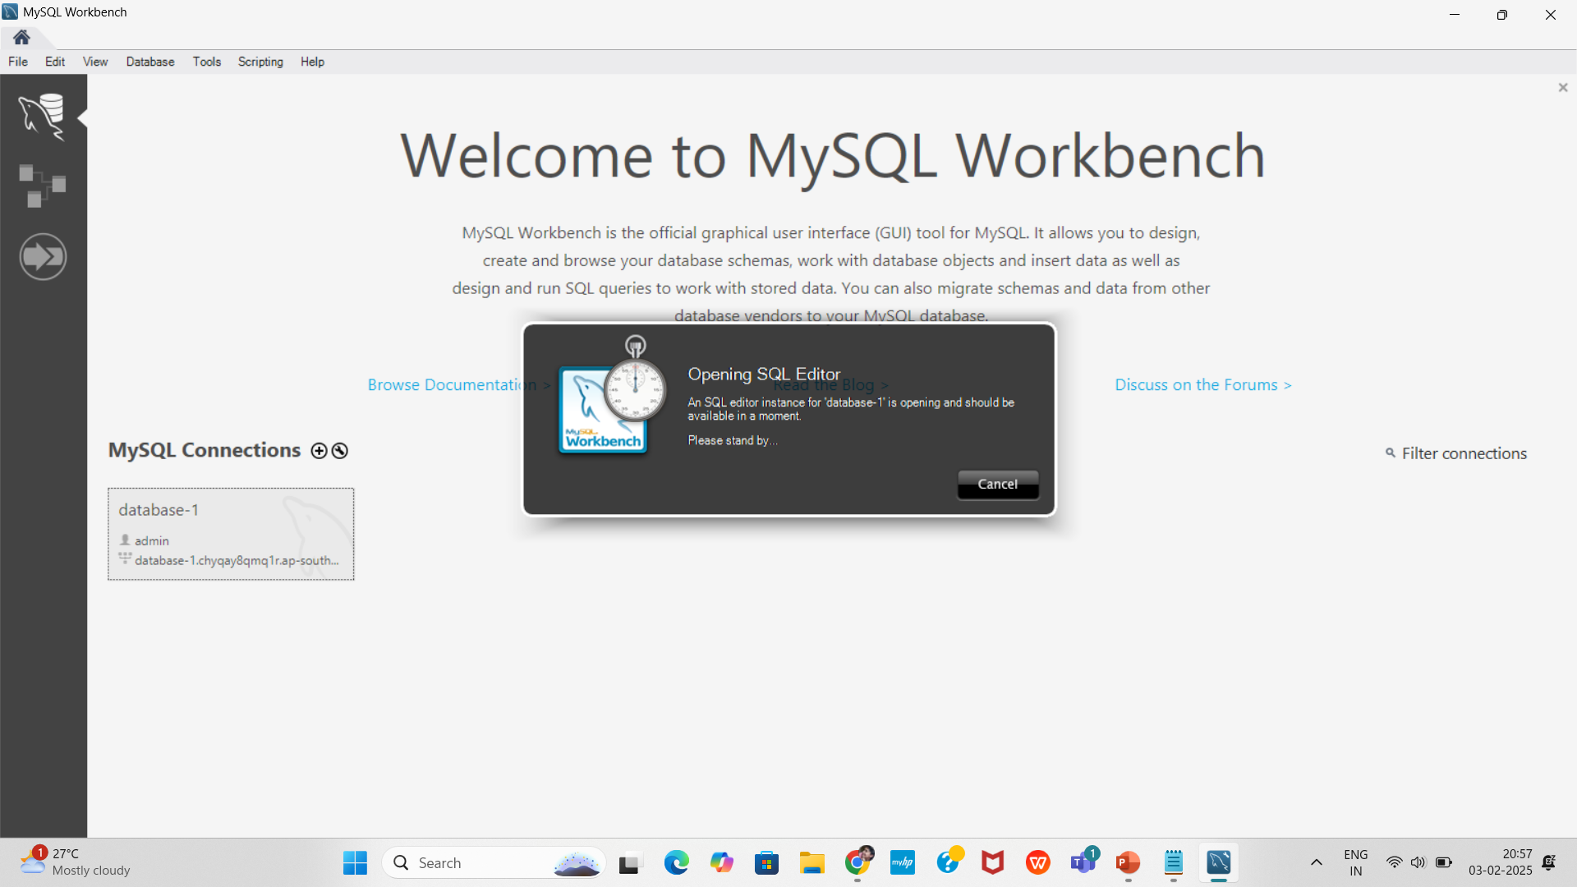
Connect to MySQL Workbench
1.Open MySQL Workbench
Click + to create a new connection
2.Enter the following:
Connection Name: database-1
Hostname: (Paste the RDS Endpoint)
Port: 3306
Username: admin
Password: Store securely or enter manually
3.Click Test Connection and Save

Slide 11
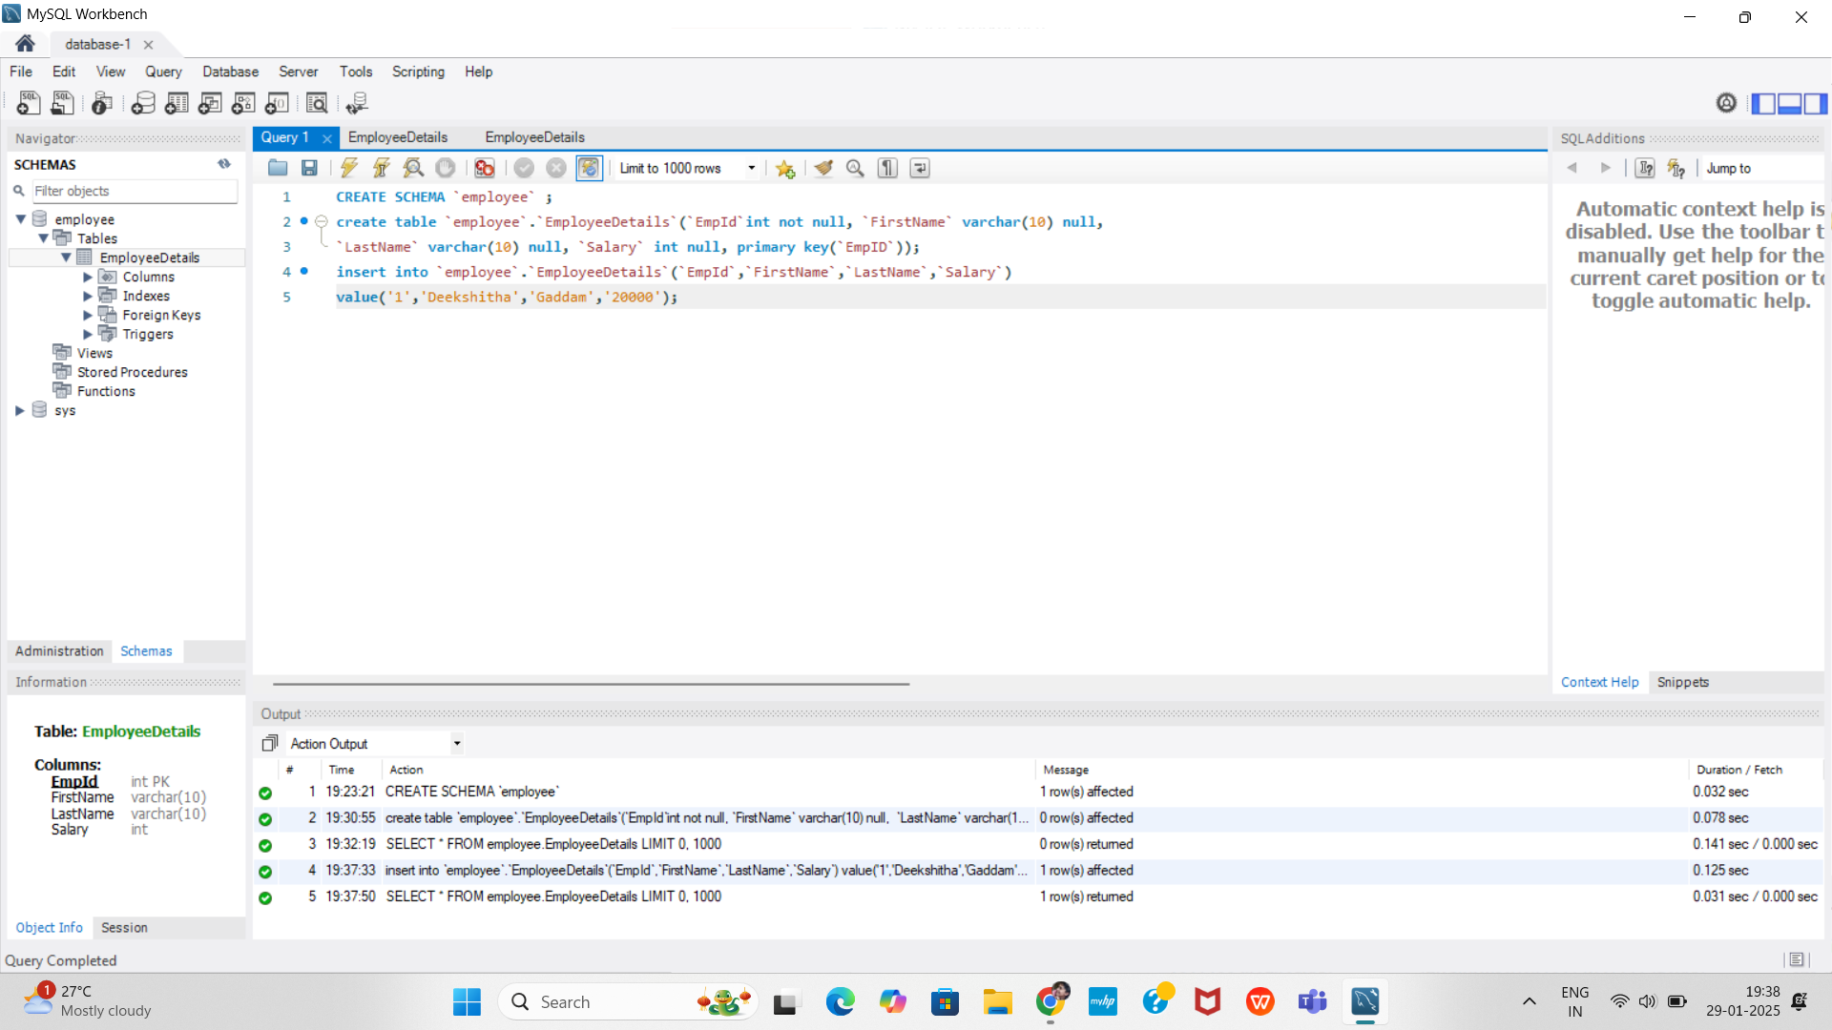
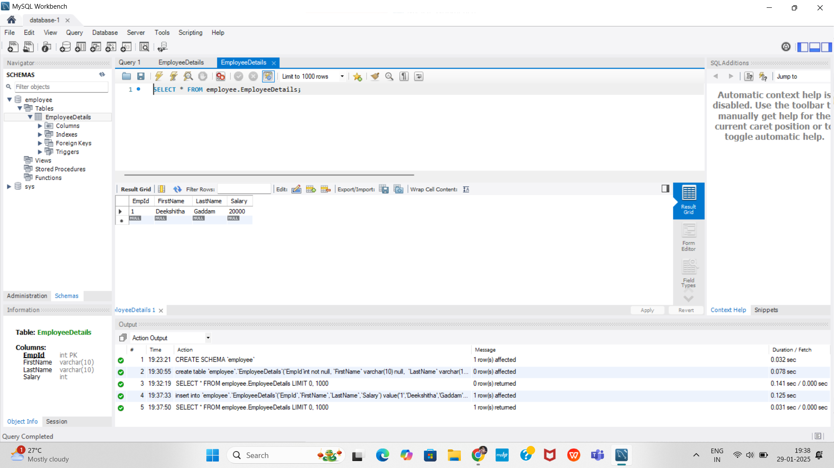
Creating a Database
Successfully connected AWS RDS MySQL to MySQL Workbench
Created a database, table, and inserted data
1.Open the SQL Editor in MySQL Workbench
Run the following SQL command:
CREATE SCHEMA `employee`;
2.Creating Tables
Define a table with columns:
CREATE TABLE `employee`.`EmployeeDetails` (
`EmpId` INT AUTO_INCREMENT PRIMARY KEY,
`FirstName` VARCHAR(10) NULL,
`LastName`VARCHAR(10) NULL, `Salary` int null );
3.Insert rows into the table:
INSERT INTO `employee`.`EmployeeDetails` (`EmpId`,`FirstName`,`LastName`,`Salary`) VALUES
(‘1’, ‘Deekshitha’,’Gaddam’,’20000’);

Slide 12
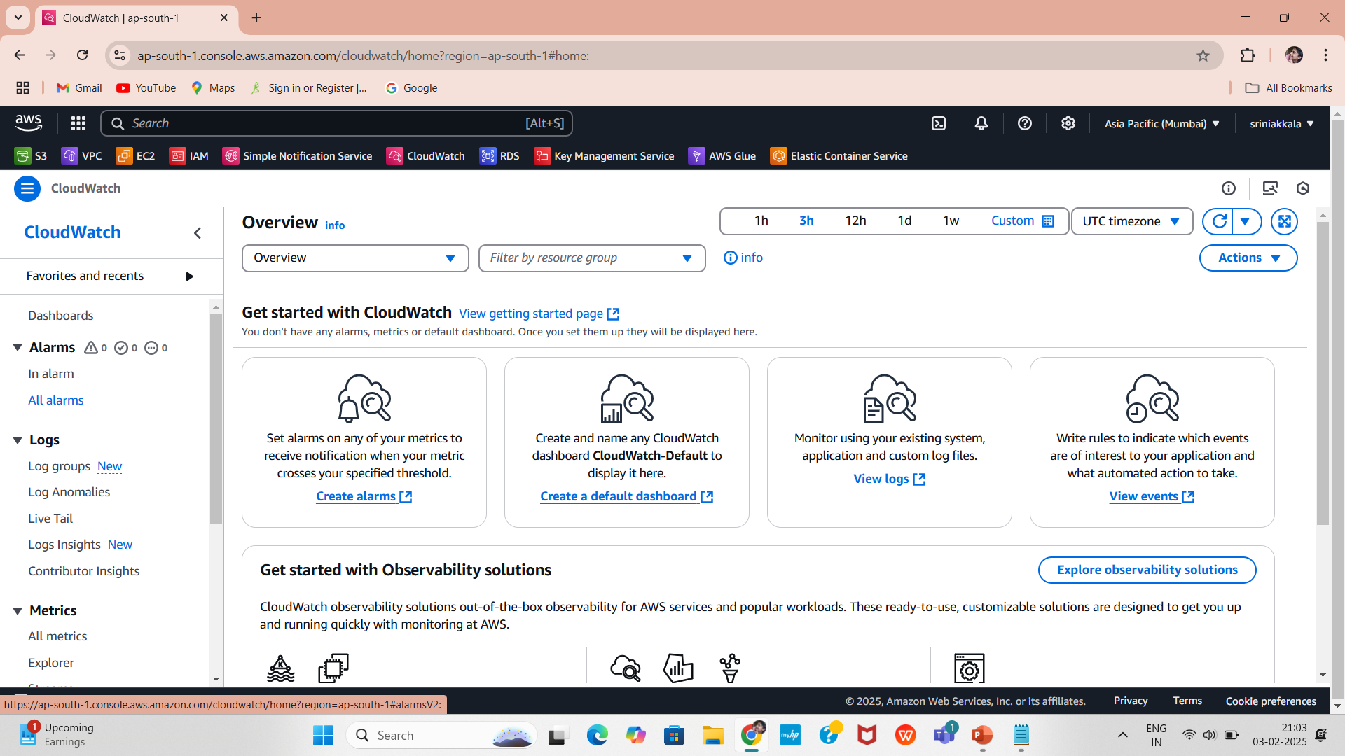
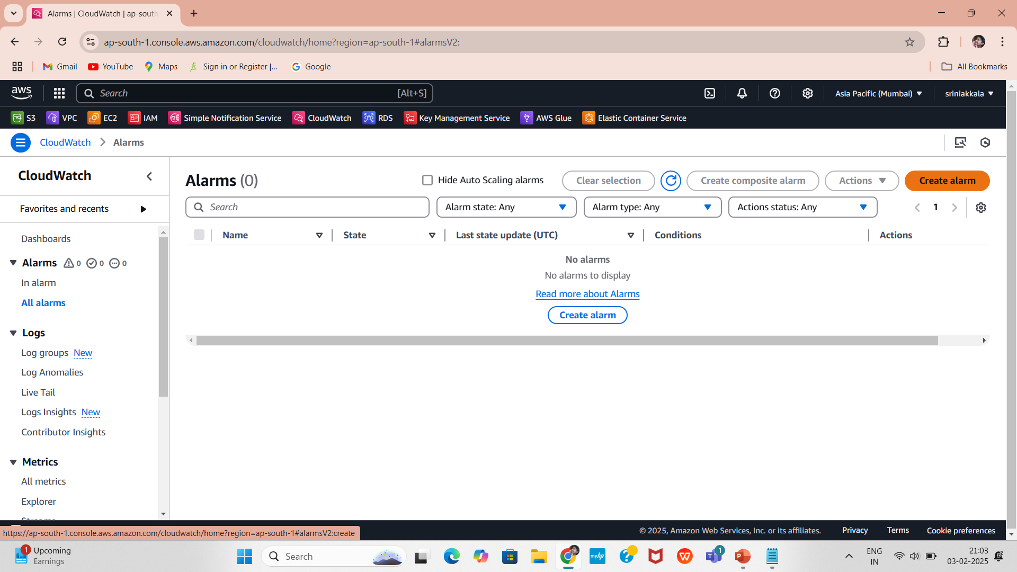
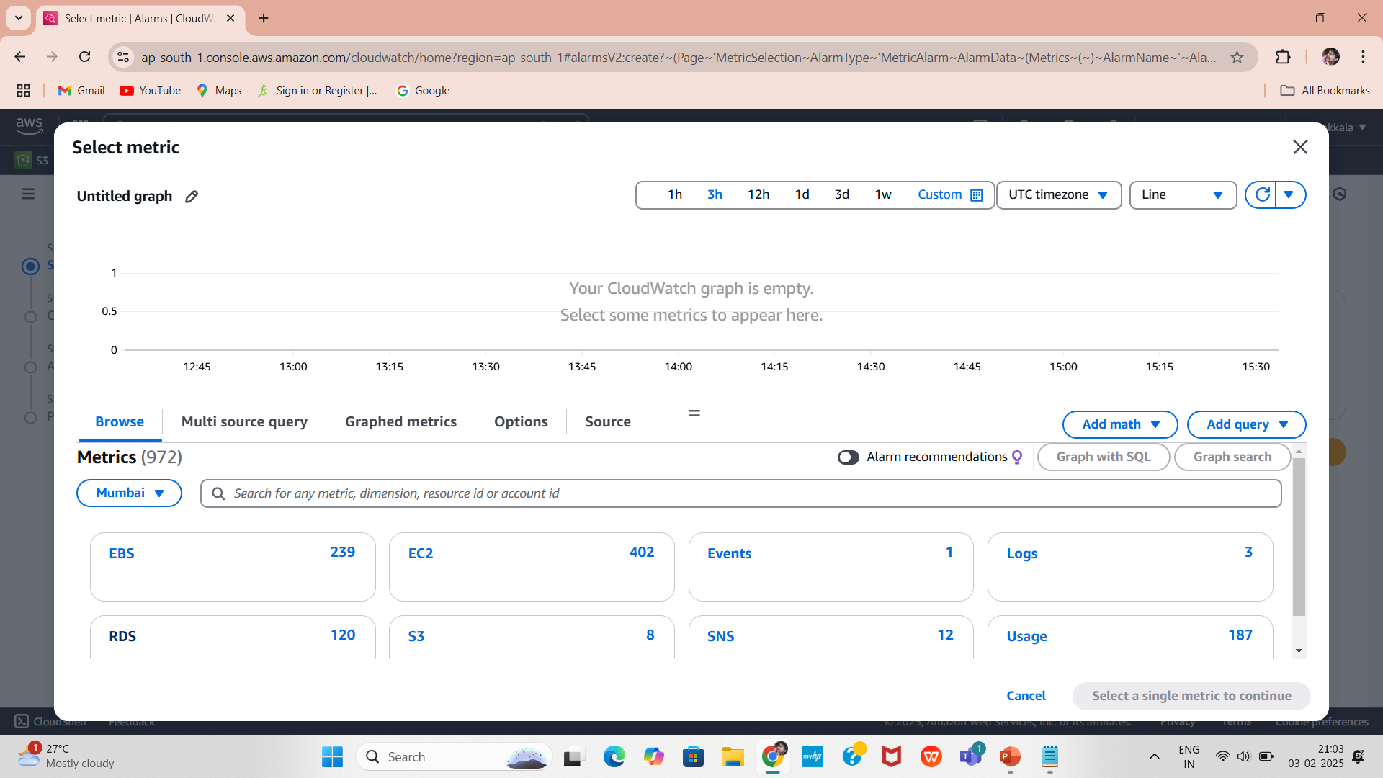
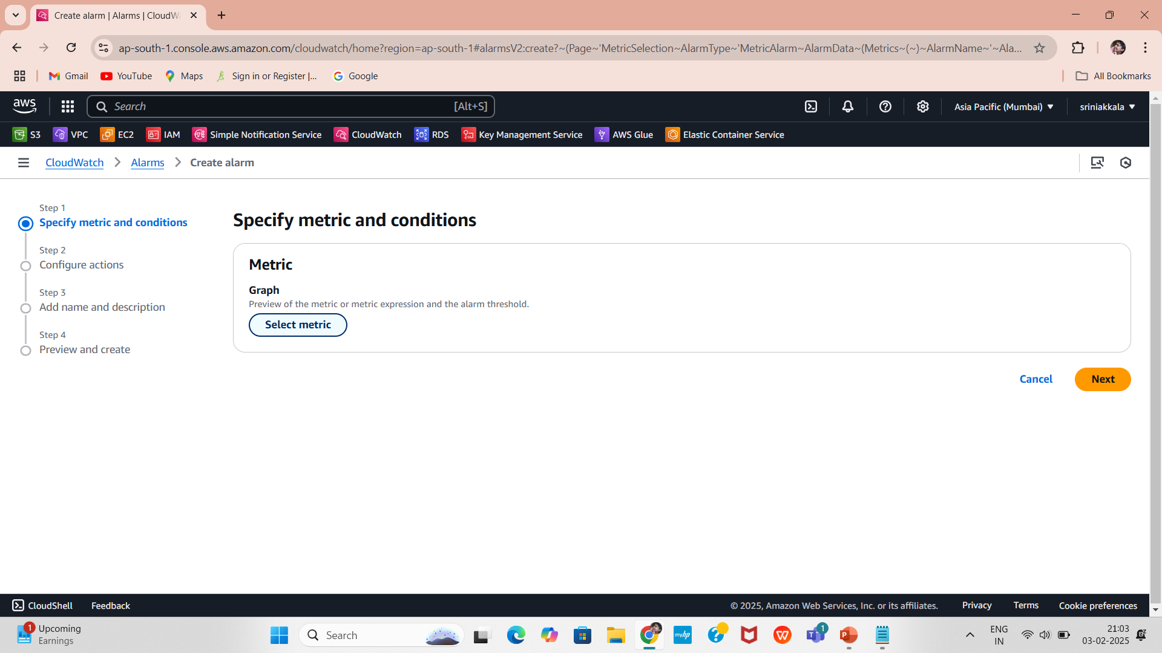
Steps to Create an RDS Free Storage Space Alarm
1.Navigate to the CloudWatch service.
Select Alarms in the Navigation Pane
Click on “Alarms” in the left panel.
2.Select “Create Alarm.”
4.Select RDS Metrics
3.Click “Select metric.”

Slide 13
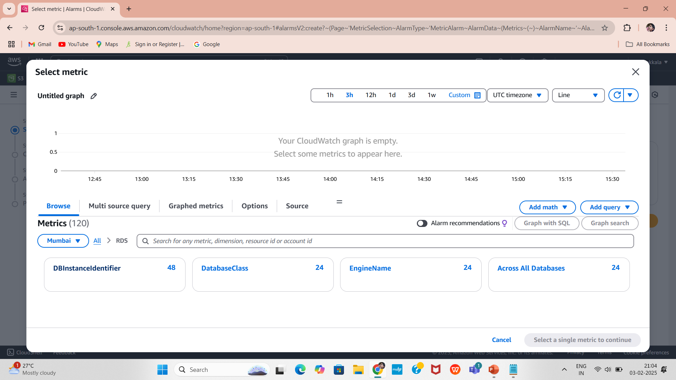
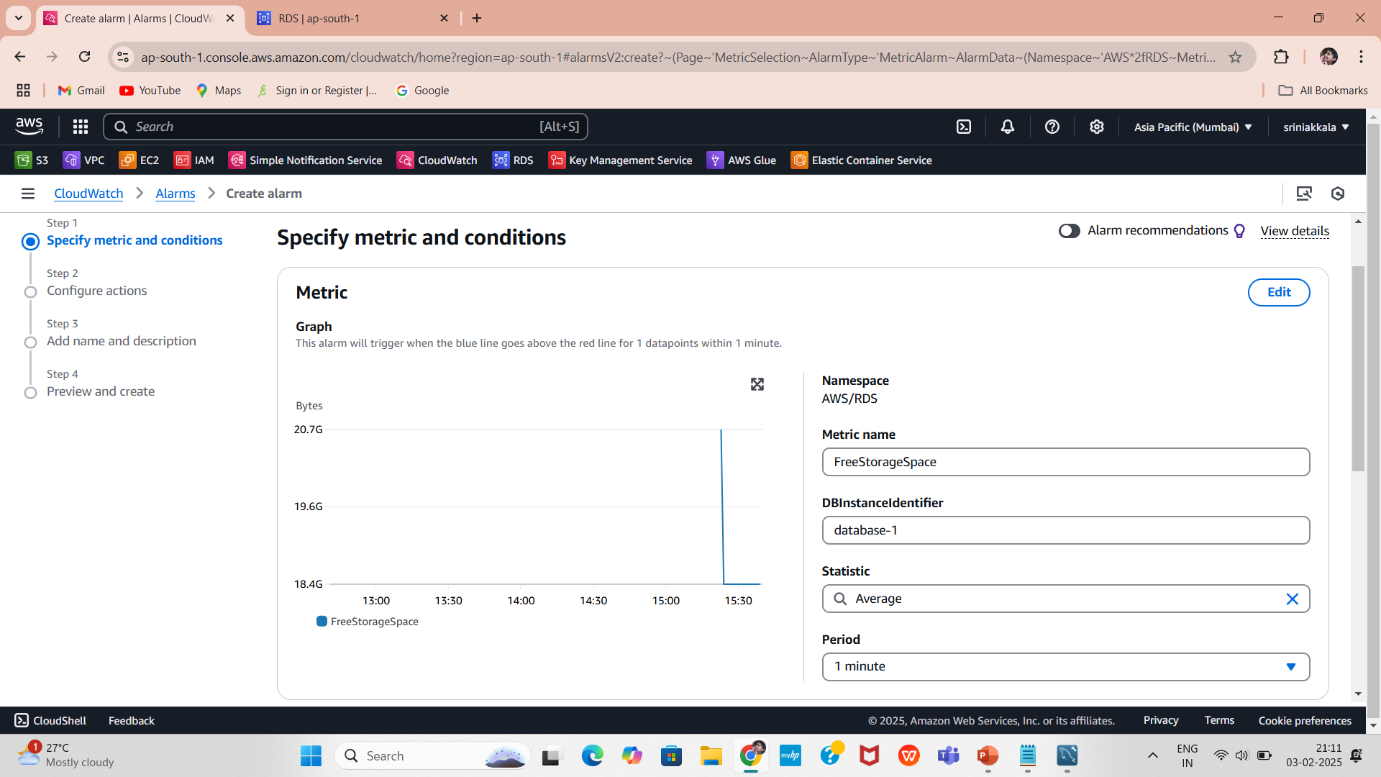
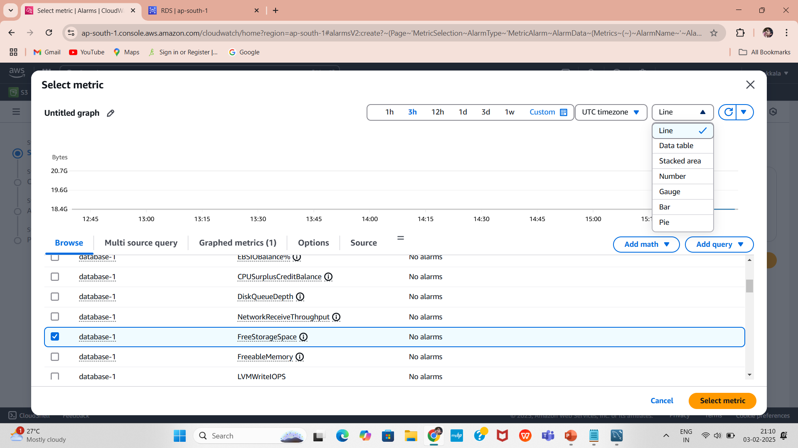
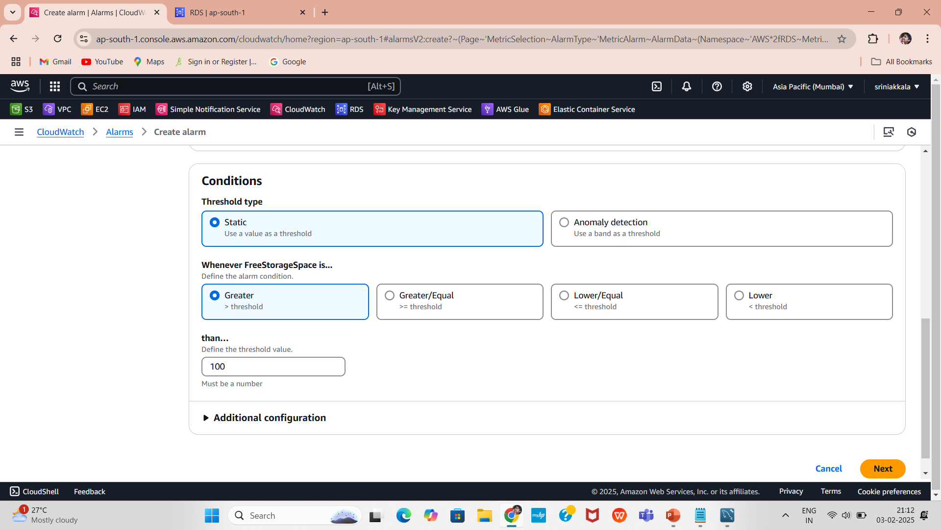
5.Navigate to “Per-Database Metrics” under RDS Metrics
Find the database using DBInstanceIdentifier.
6.Select the metric FreeStorageSpace.
7.Define Alarm Conditions
Set the threshold for free storage space (e.g., below 1GB).
Choose a period and data aggregation method (e.g., average over 1 minutes).

Slide 14

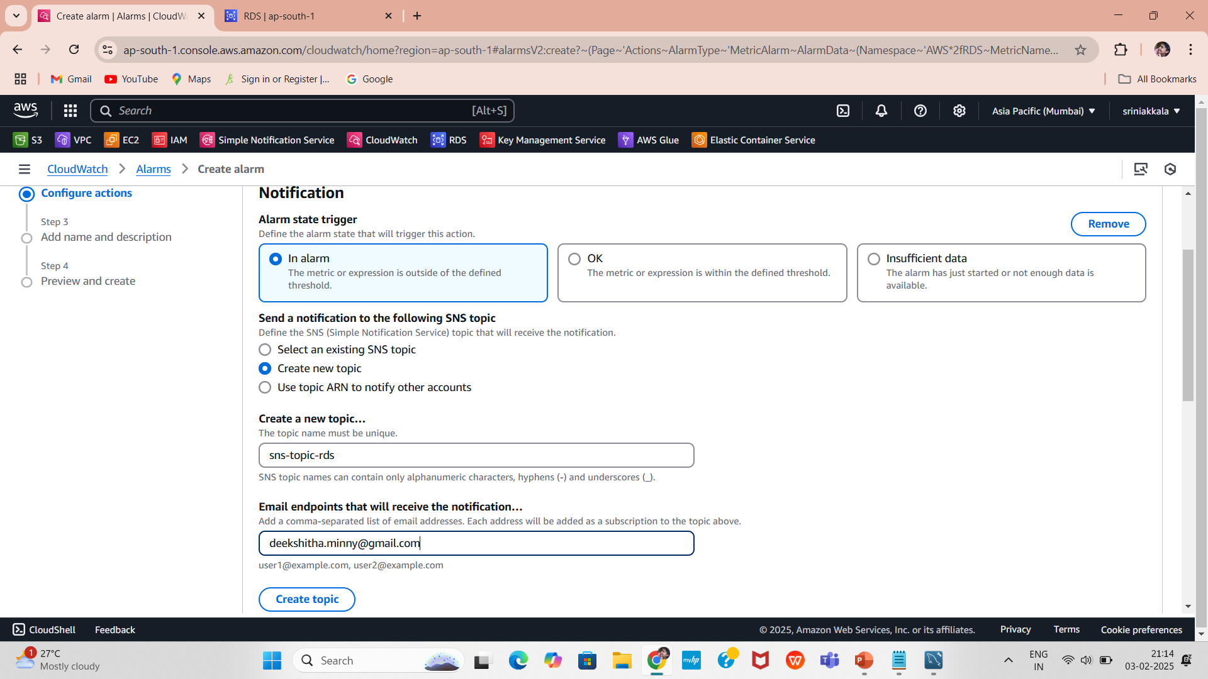
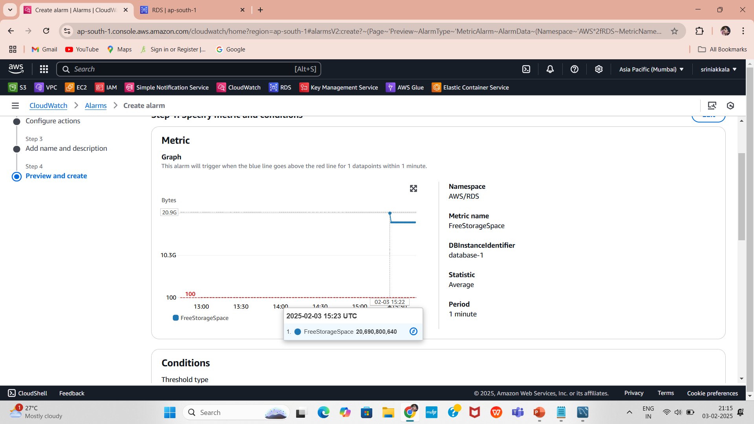
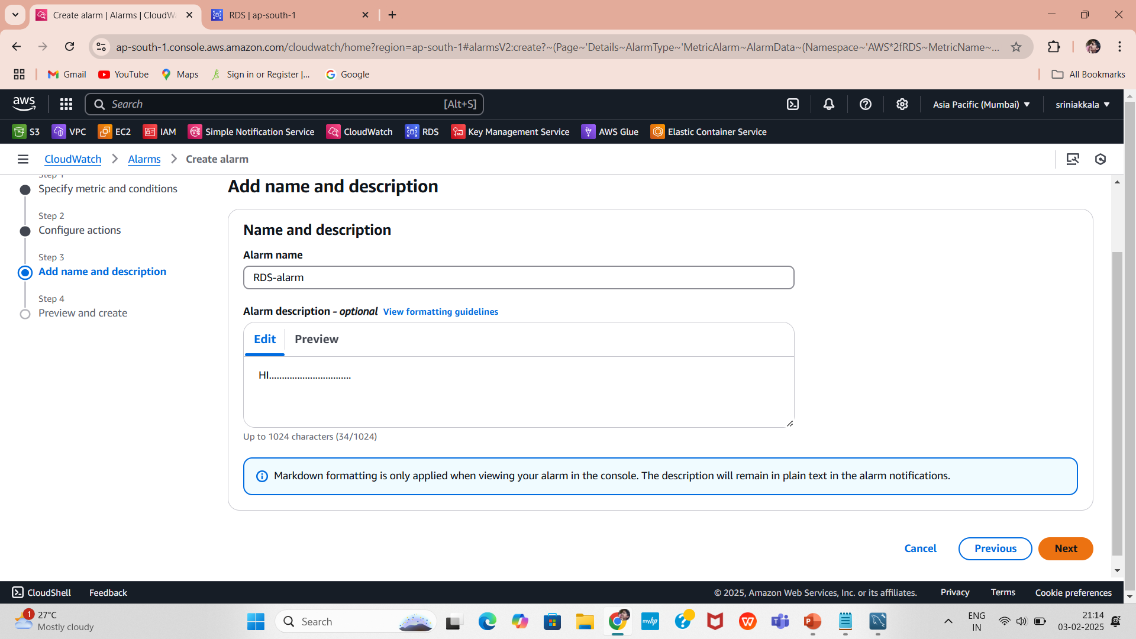
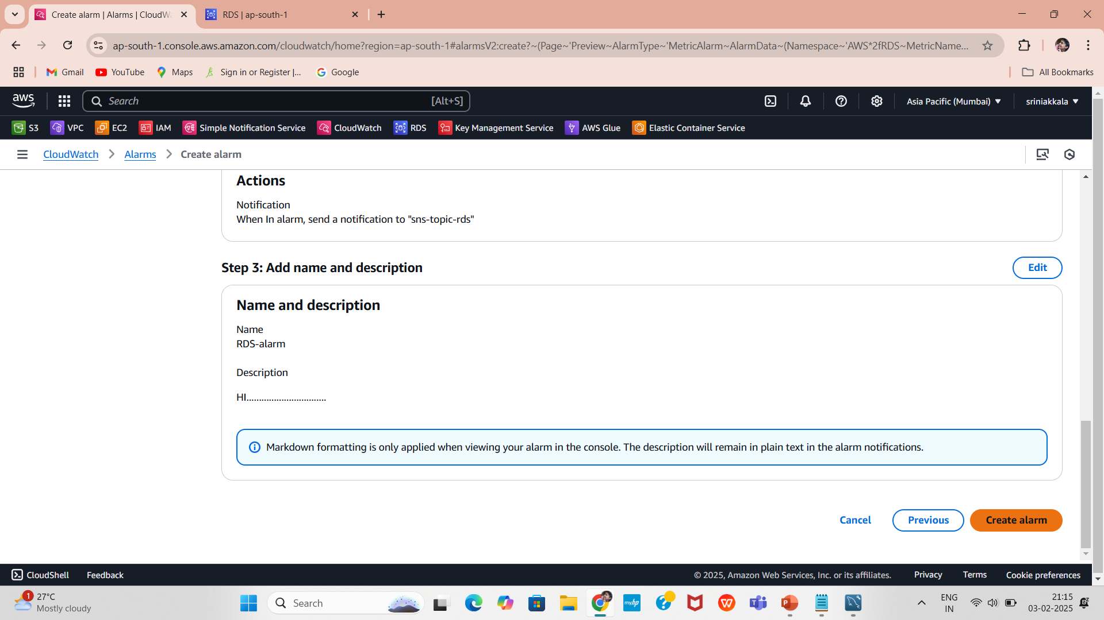
8.Add Notification Action
Choose "Send Notification to an SNS Topic."
If no SNS topic exists, create a new one.
Subscribe an email address to the SNS topic.
Click on Create topic.
9.Finalize the Alarm
Enter a name and description for the alarm.
10.Review the settings and click "Create Alarm."

Slide 15
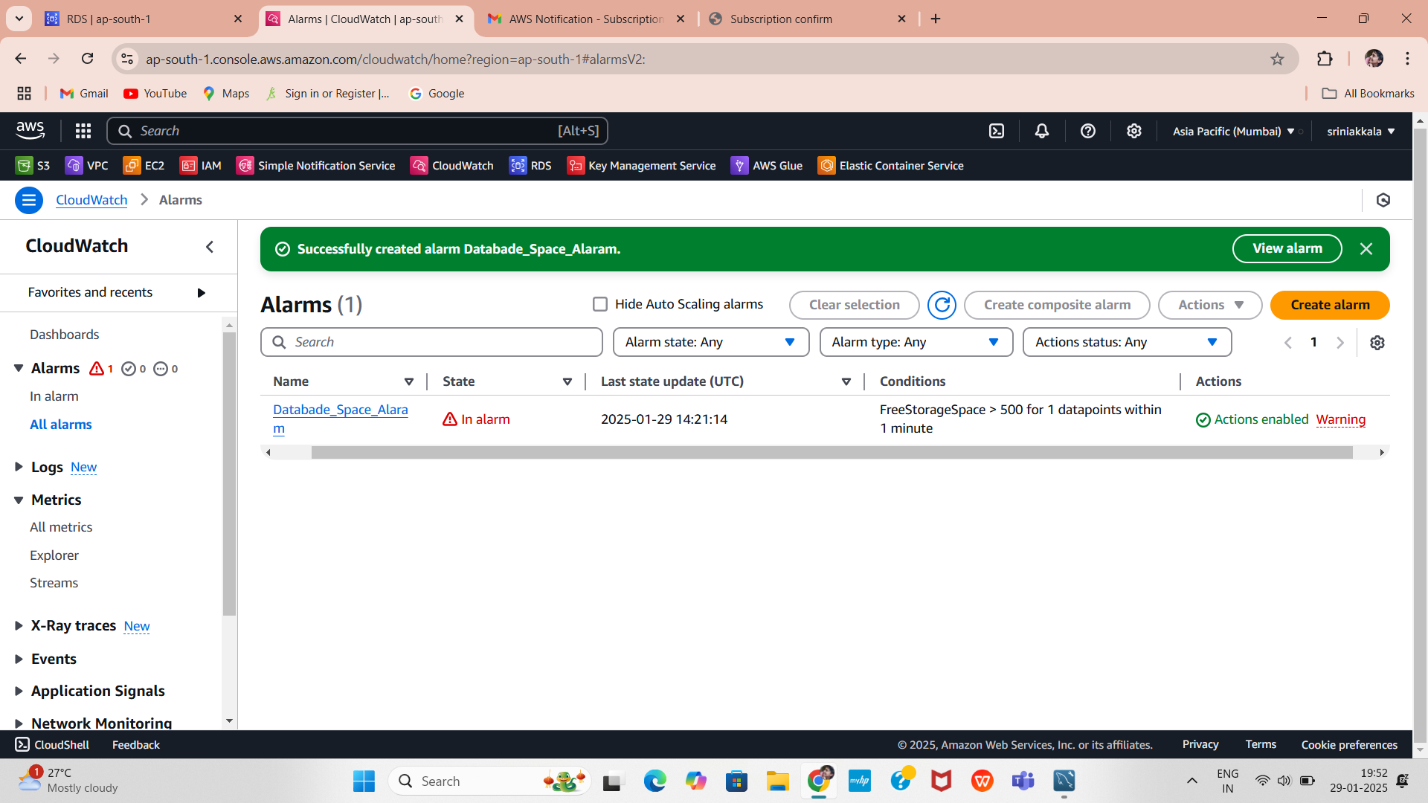
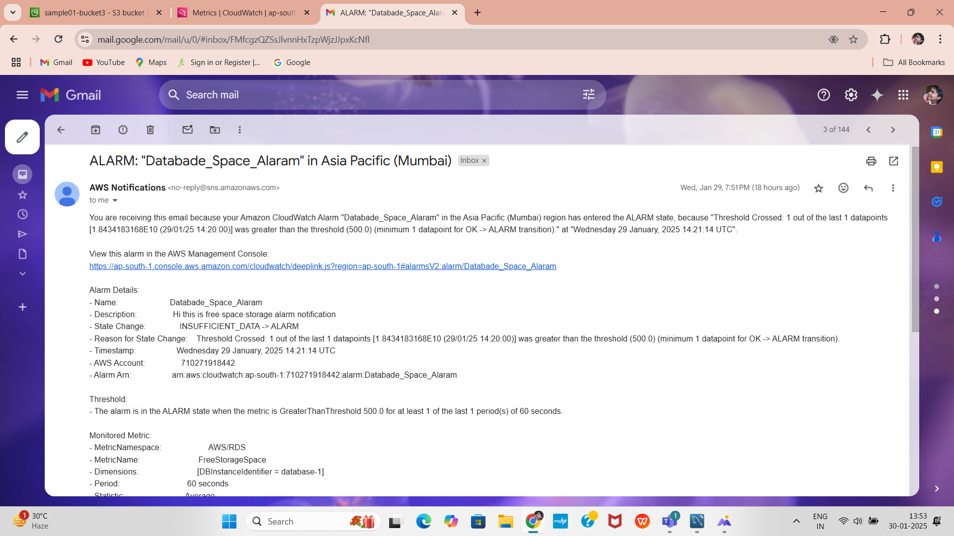
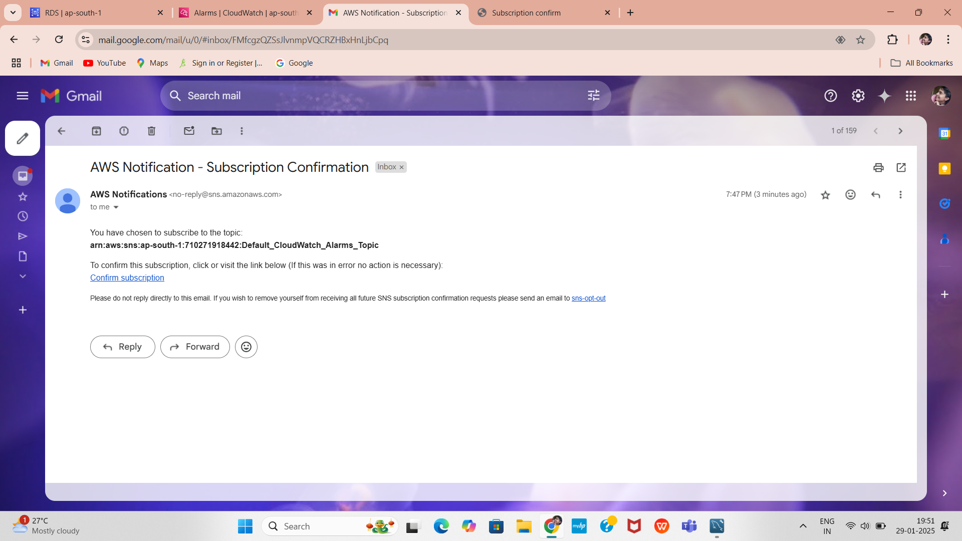
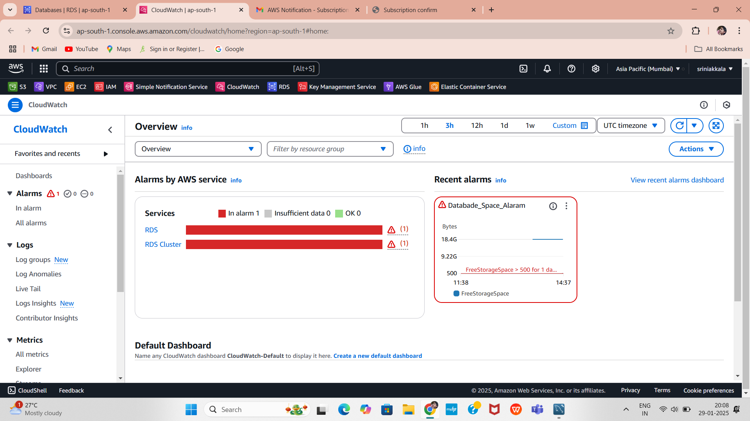
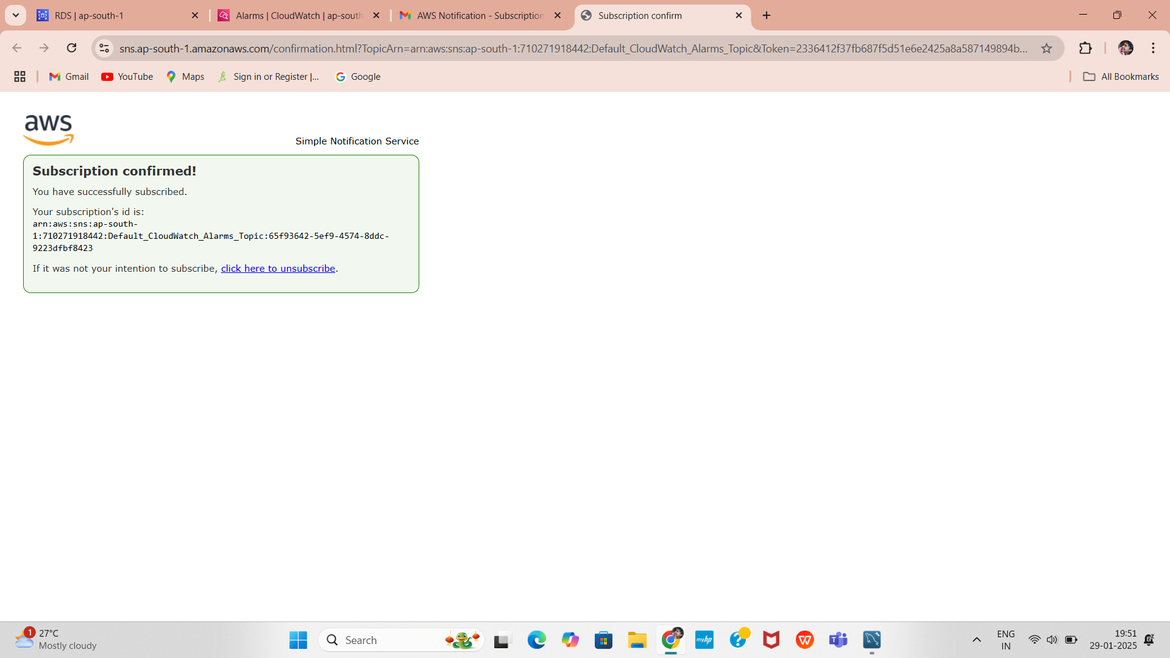
Testing and Validation
1.Check the Alarm Status
3.Trigger the Alarm Manually
Reduce storage space (for testing purposes).
Ensure the alert email is received from AWS SNS.
2.Confirm Email Notifications
After creating Alarm you get AWS-Notification for Subscription Conformation
in your Email .

Slide 16
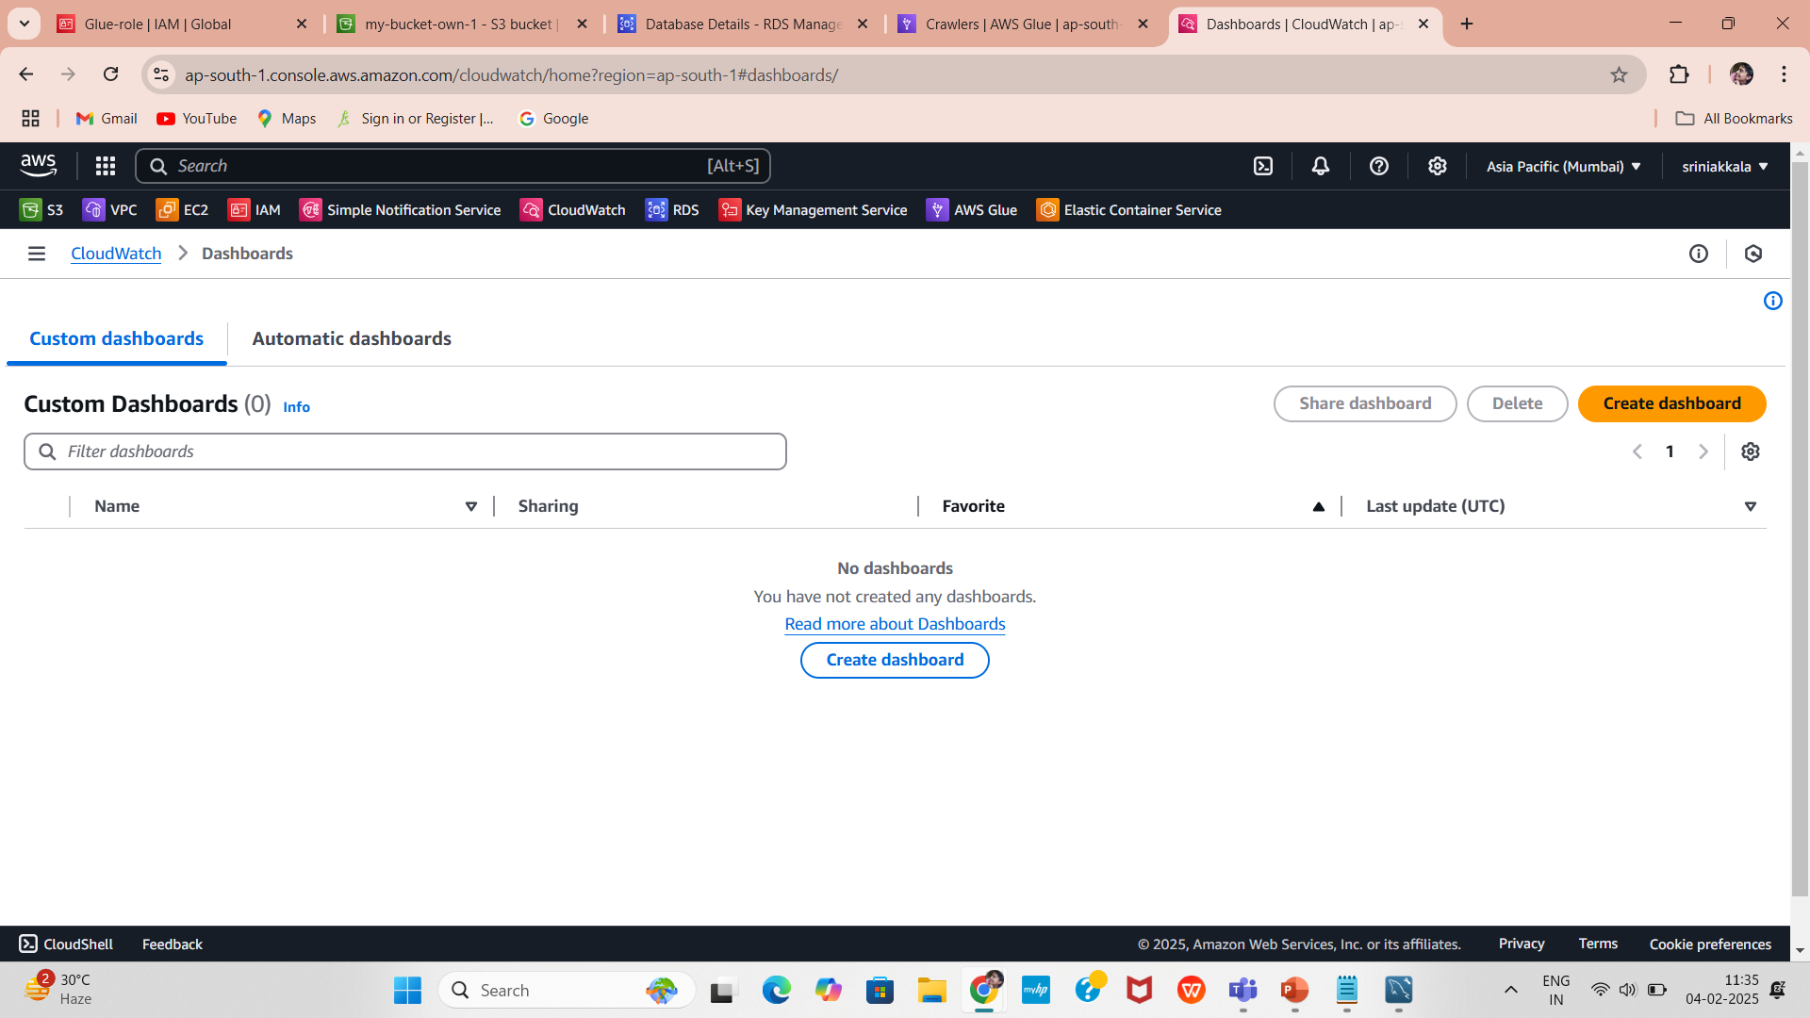
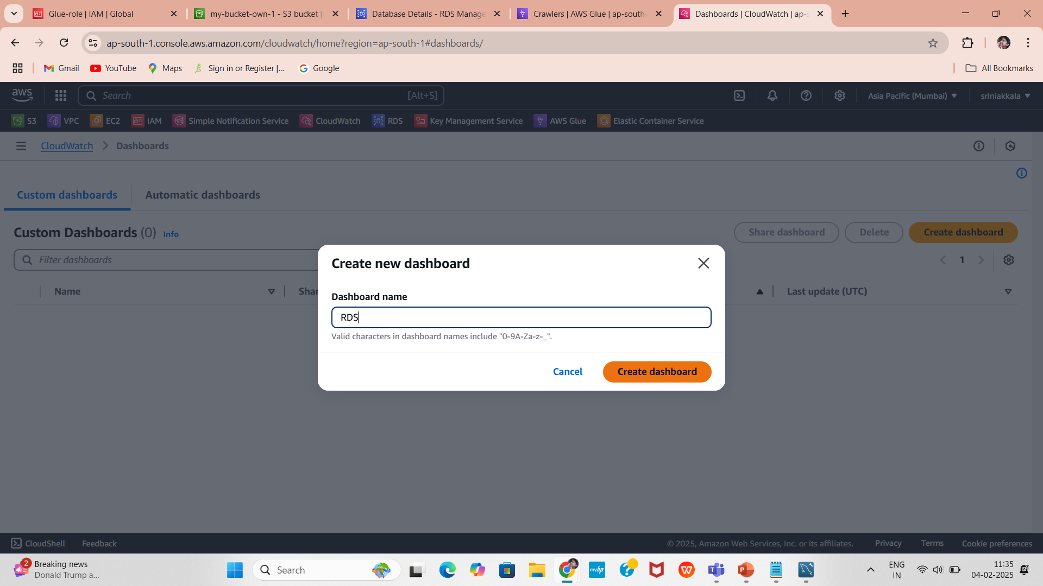
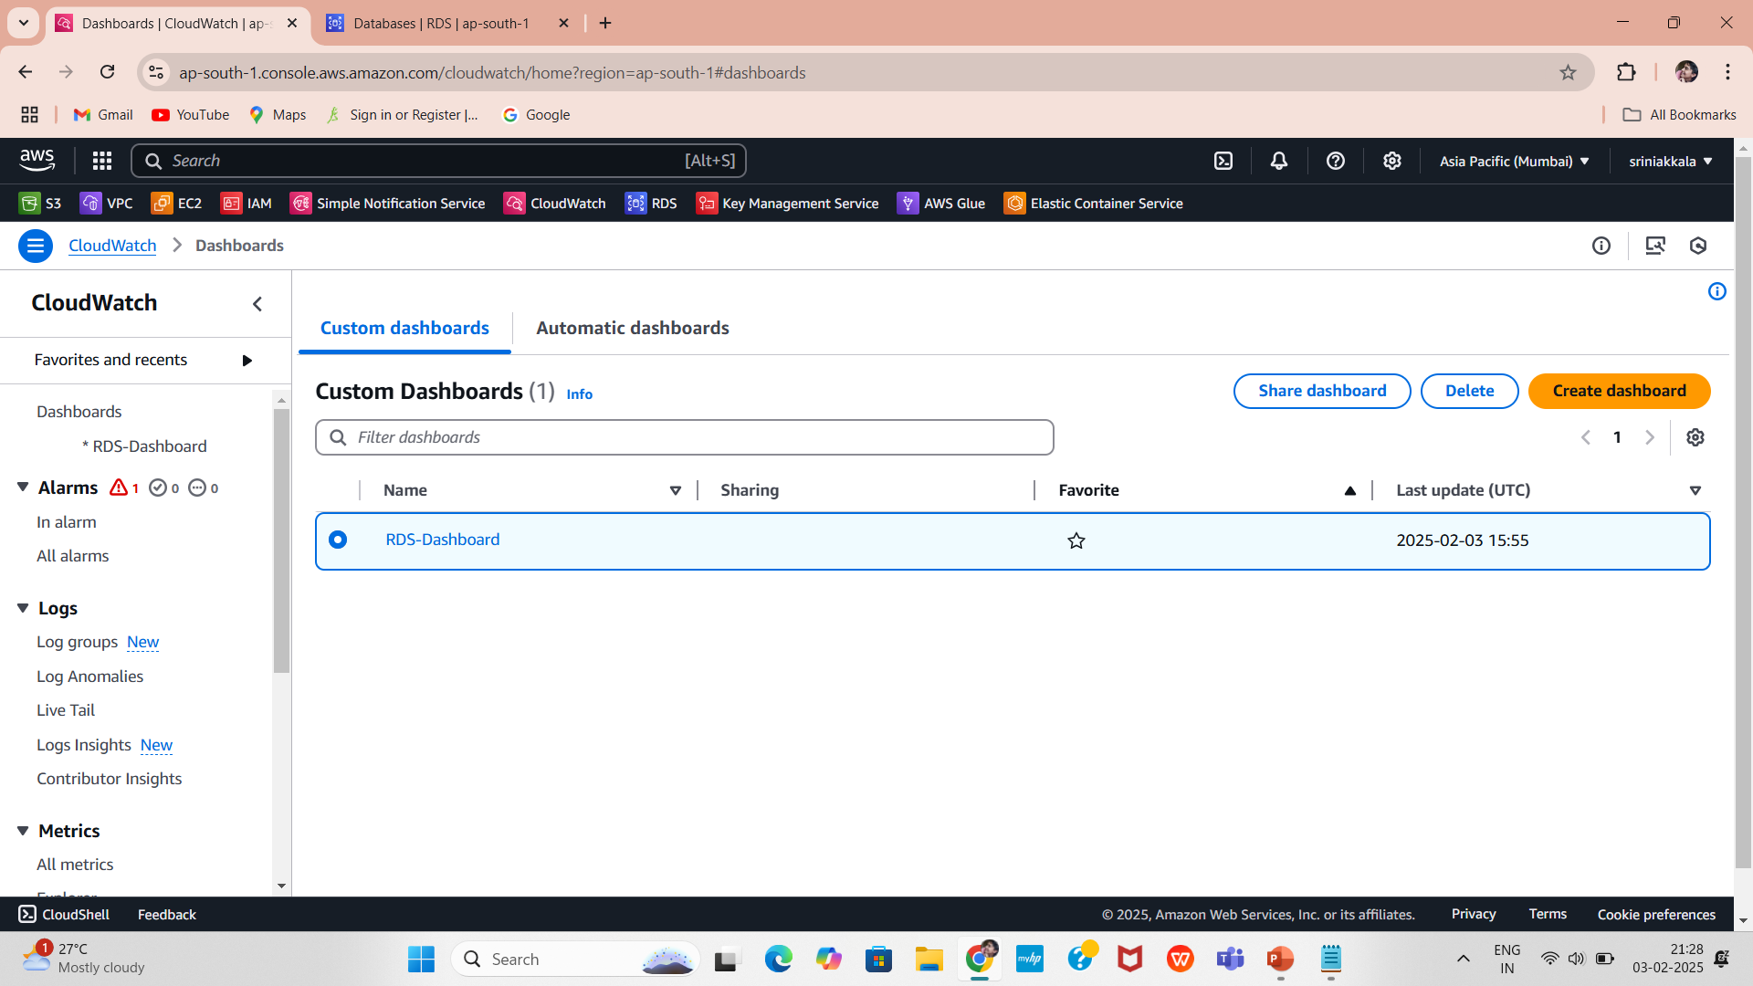
Create a New CloudWatch Dashboard
In the CloudWatch Console, click on Dashboards in the left panel.
Click on Create dashboard.
Enter a name for your dashboard (e.g., RDS-Dashboard).
Click Create dashboard.
Here we can see the created Dashboard RDS-Dashboard,
Now click on it for next creations.

Slide 17
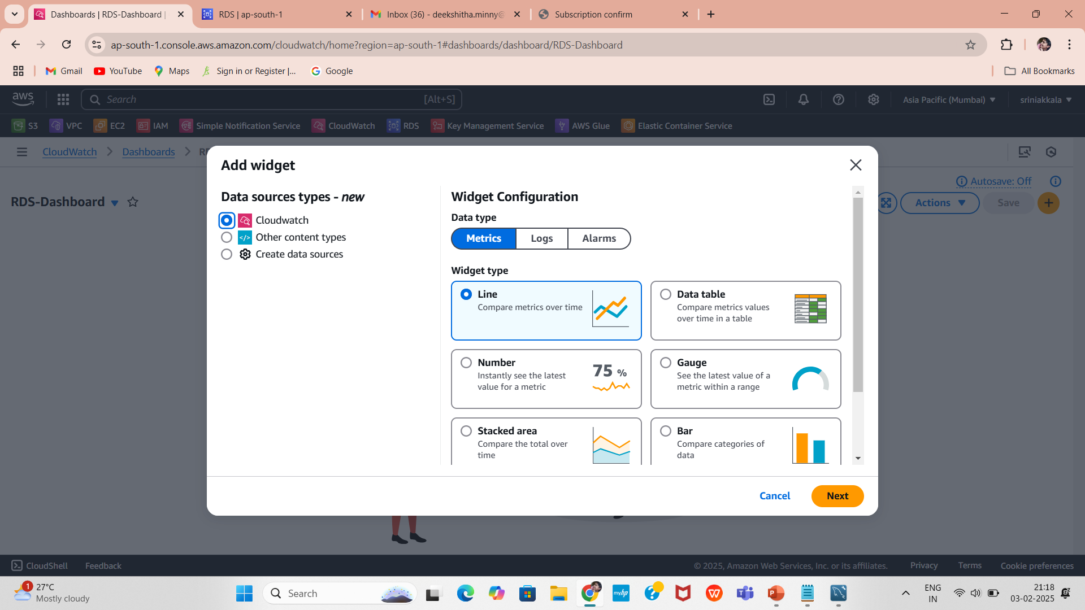
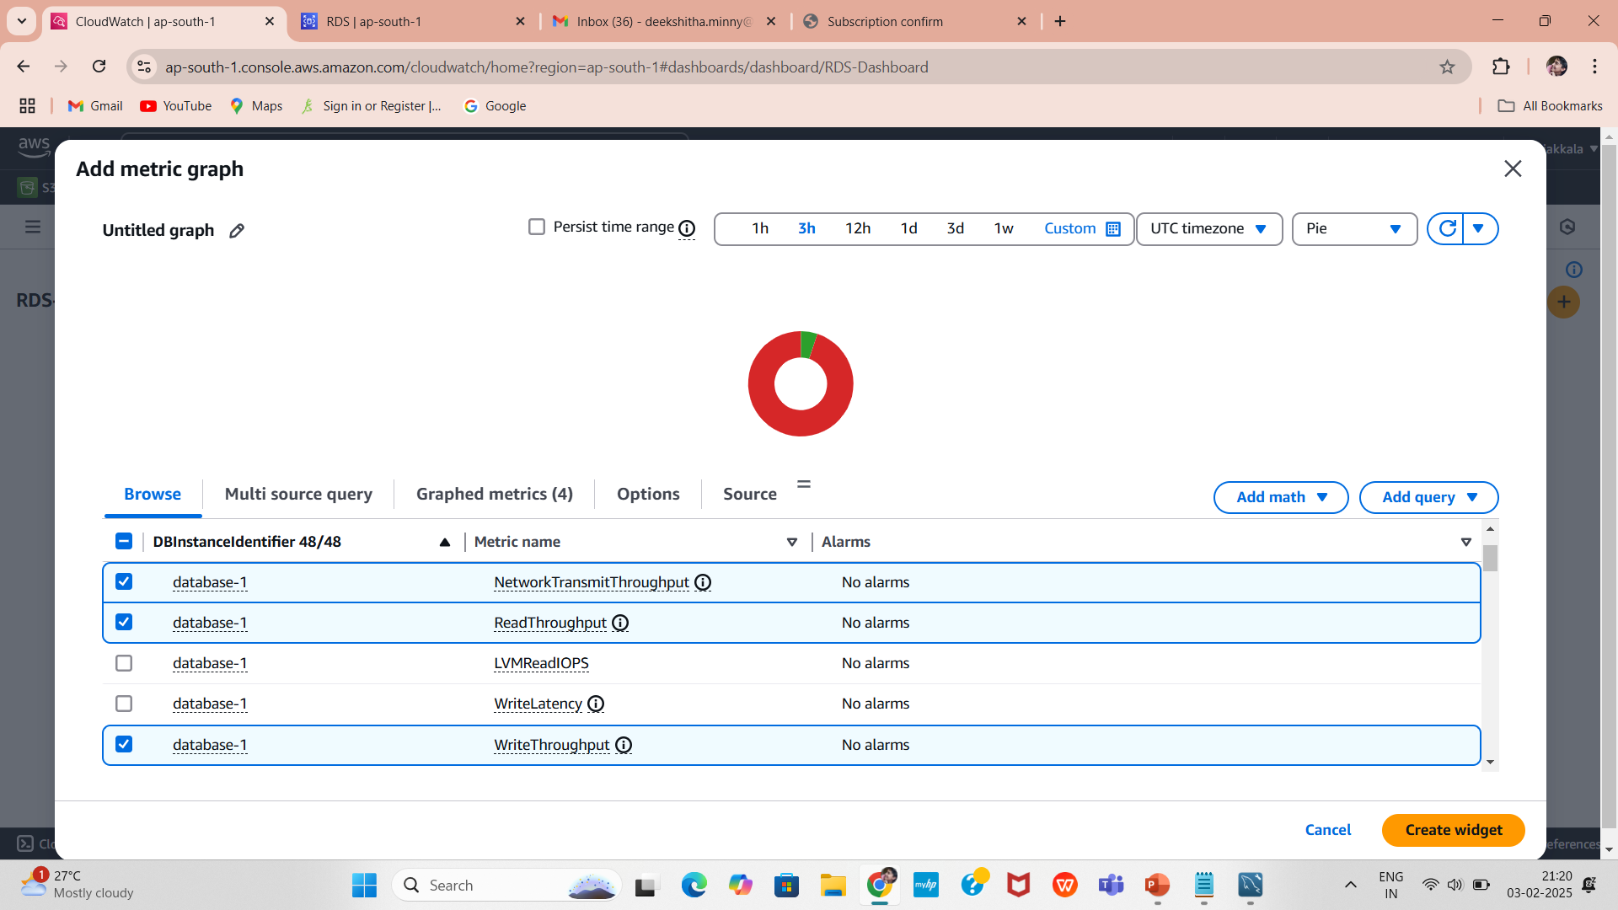
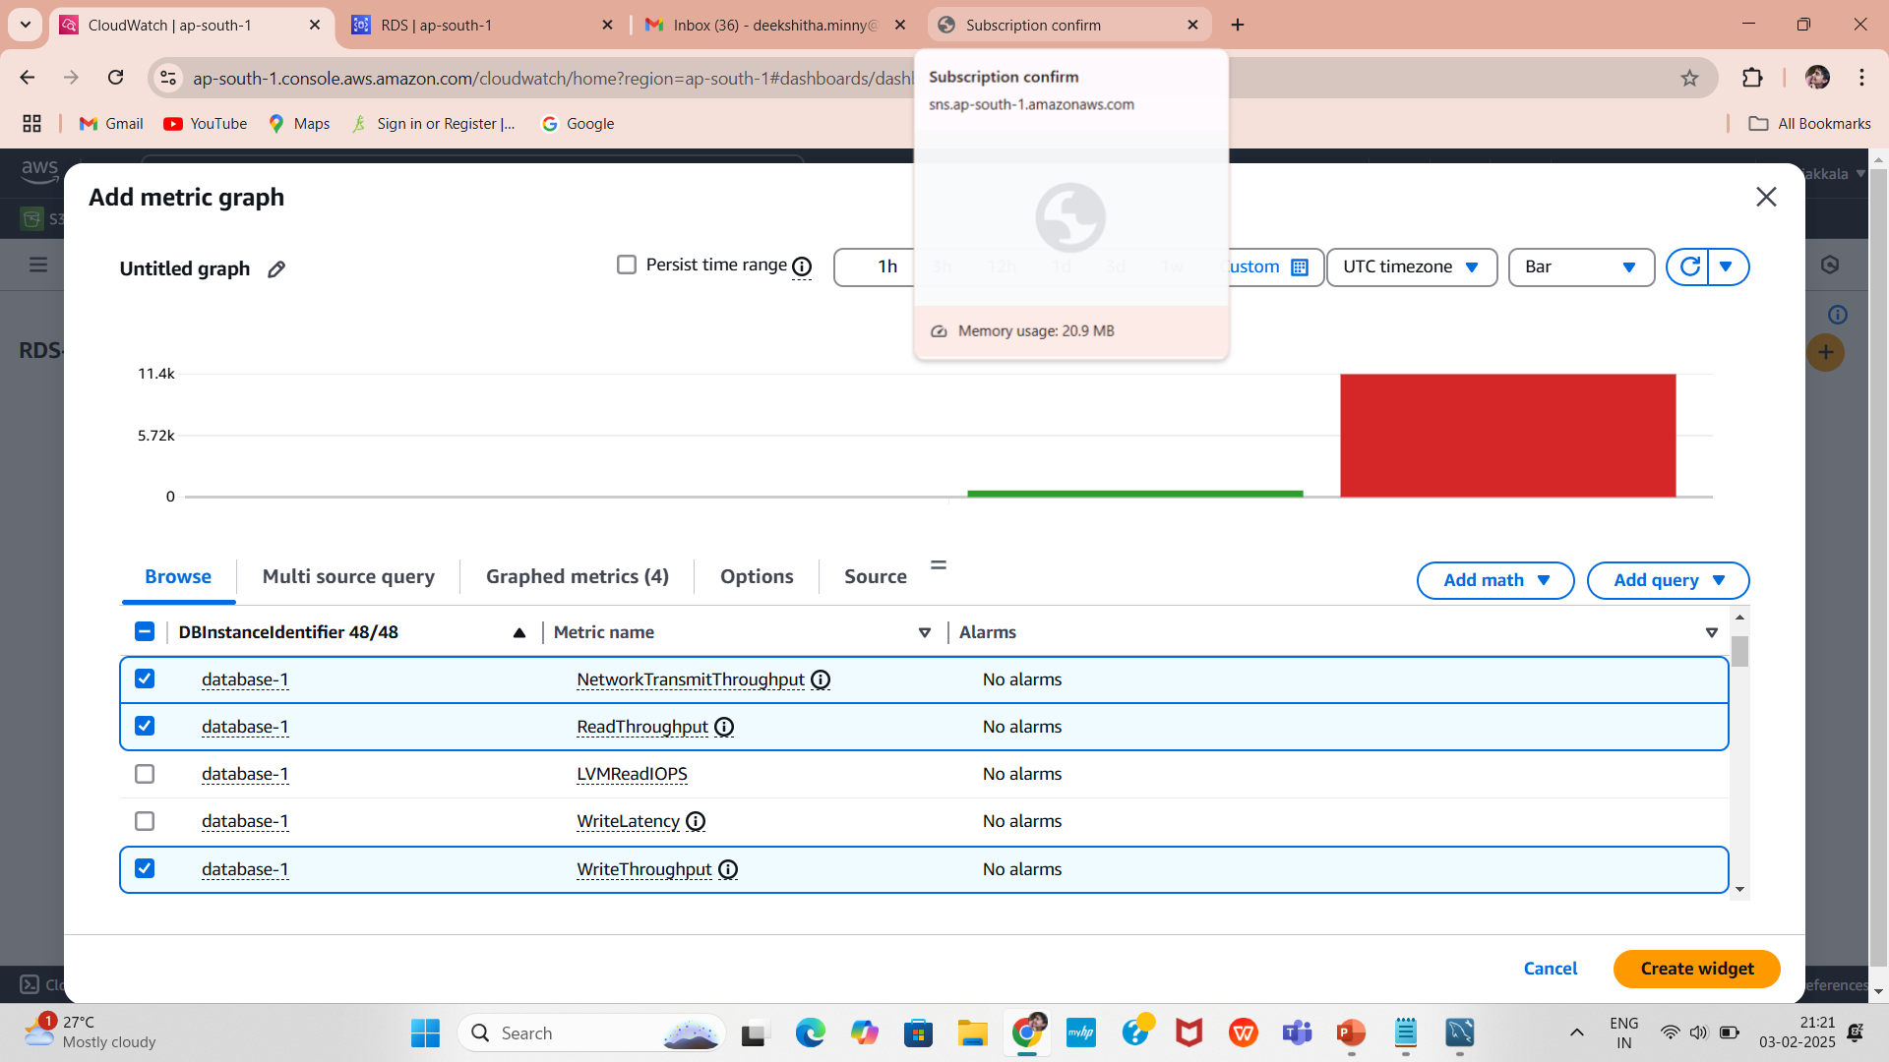
Choose the Type of Widget Visualization
After clicking on Add widget, you can select from the following widget types:
Line Graph 📈
Number 🔢
Pie Chart 🥧
Stacked Area 📊
Bar Chart 📉
In the Add metric graph window, click Browse and select:
AWS/RDS → Metrics related to your RDS database.
Choose the metrics you want to display. Common RDS metrics include:
CPUUtilization – To monitor CPU usage.
FreeStorageSpace – To track available storage.
DatabaseConnections – To see active connections.
ReadIOPS / WriteIOPS – For monitoring read/write operations.
NetworkReceiveThroughput / NetworkTransmitThroughput – To check network traffic.

Slide 18
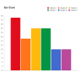






Customize the Dashboard
Bar Chart
Add multiple widgets to display different metrics.
Drag and resize widgets as needed.
Click Save dashboard.
Helps compare multiple metrics.
Example: Comparing different RDS instance CPU utilizations.
Pie Chart
Shows metric distribution as a percentage.
Example: Distribution of database connections across multiple instances.
Line Graph
Best for tracking trends over time.
Example: Monitoring CPU utilization or FreeStorageSpace.
Number
Displays a single numeric value.
Example: Showing the current active database connections.
Stacked Area
Useful for showing multiple metrics stacked on top of each other.
Example: Stacking ReadIOPS and WriteIOPS.

Slide 19

Summary
By implementing this alarm, you ensure that your RDS database has enough storage, avoiding service disruptions and improving system reliability. Always review and adjust the alarm settings based on your workload to keep your database running smoothly.

Slide 20

Thank you
G.Deekshitha

